Slide 1
NHS Leadership and Management Framework
July 2026
Notes:
Standard title slide

Slide 2
Leadership and Management Framework
The new NHS Leadership and Management Framework has been developed to recognise, support and professionalise leadership and management consistently across the NHS, in response to the Messenger and Pollard Review (2022). It sets consistent, professional standards and competencies across all levels of NHS leadership and management, clinical and non-clinical, and for the first time a single, national code of practice across health and social care
Launched on 6th July 2026, the expected adoption of the new Framework has now been committed in a letter to the service, as well as in the 10 year health plan and the Medium Term Planning Framework:
  All NHS organisations should start work in implementing the Framework from summer 2026, adopting the new standards and adapting existing local communications, strategies, policies, training, appraisal and recruitment processes in order to align with the new framework.
  All leaders and managers should self-assess against the standards and access development to work towards achieving the standards over time
The new NHS College of Leadership and Management will provide the national architecture for leadership and management, bringing together the Framework, standards, development, talent pipelines, and career pathways into a single, coherent system
Uptake of the framework will be monitored as part of formal and informal governance arrangements from launch, including access to the self-assessment tool, 360 and modular training, ongoing evaluation and feedback, communities of practice and inclusion in existing data collection and survey opportunities

Slide 3
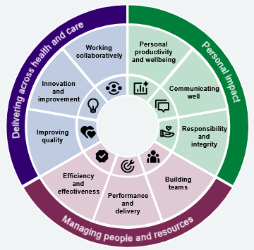
Leadership and Management Framework - resources
A number of resources are being developed to accompany the Framework and support its implementation over the course of 2026.
Available now is a freely accessible microsite including the code of practice, standards and competencies and guidance to help individuals select the right level for them as well as the new self-assessment tool
Available later in 2026 will be a free a 360° tool, a comprehensive suite of free, self-directed online learning, fully aligned to the standards at all levels and a national development curriculum at all levels
Over time, more resources and materials will be developed and shared to help support implementation
All existing national development offers will also be refreshed to align with the standards, including all Leadership Academy programmes, the NHS Graduate Management Training Scheme, bitesize learning and regional offers.

Slide 4
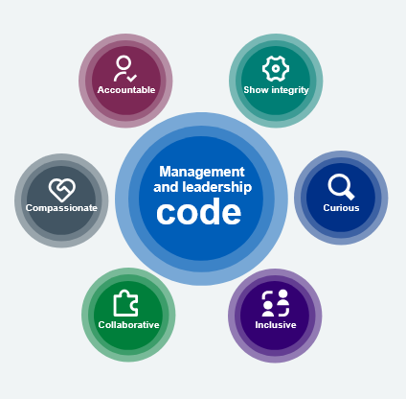
Draft Leadership and Management Code for health and social care
Be accountable: Take responsibility for your actions and decisions. Hold yourself and others to account for doing the job well, working together fairly and effectively and always looking for ways to improve. | Be collaborative: Build productive relationships based on respect and trust. Bring in different views and work across teams and organisations. Make sure everyone is included, heard and supported – especially when things are changing. | Be compassionate: Lead with thought and consideration. Show care and understanding for others – and for yourself. Support people so they feel at home in teams and can thrive.
Be curious: Stay open and questioning. Use evidence, listen to diverse views, challenge old assumptions – and find better ways of doing things. | Be inclusive: Confront discrimination, bullying, harassment and inequality. Ask who is missing, who isn’t being heard, and why – and then act to address biases and unfairness. | Show integrity: Stay true to your values, even under pressure. Be honest and open. Stick to the highest professional and ethical standards.

Slide 5
Stages of the Leadership and Management Framework
Stage 1: New and first line leaders and managers
This stage supports individuals in their first supervisory, leadership, or management role, typically with responsibility for just one team or line of accountability.
The competencies help new and first-line leaders and managers understand what is expected of them as they begin to take responsibility for the work of others, in addition to their own.
Fundamental Stage
This stage outlines the basic skills and knowledge required of every leader and manager (together with the stage specific competencies) and supports those preparing for their first steps into a leadership or management position by setting out the minimum standard and expectations for those leading or managing in healthcare settings.
Stage 2: Mid-level leaders and managers
This stage supports individuals who have been operating as accountable leaders or managers for a number of years.
The competencies enable these experienced professionals to navigate the bridge between senior leadership and frontline delivery, aligning team performance with broader organisational goals.
Stage 3: Senior leaders and managers
This stage supports individuals delivering operationally and accountable at a senior management level.
The competencies enable these established leaders to translate organisational strategy into action, lead larger or more complex areas, and influence across functions or systems.
Stage 4: Board level leaders and managers*
This stage supports individuals operating and accountable at the most senior level of their organisation, including Executive Directors, Non-Executive Directors and Board Members.
The competencies enable these leaders to set or oversee strategic direction and vision, shape organisational culture, and collaborate with peers and stakeholders to deliver national and ministerial priorities.
* To note: the Board Member Leadership Competency Framework (LCF) remains in place for 26/27 for the purpose of Fit and Proper Persons Test assessment at board level. We will update it for 27/28 onwards, so the two frameworks align.

Slide 6
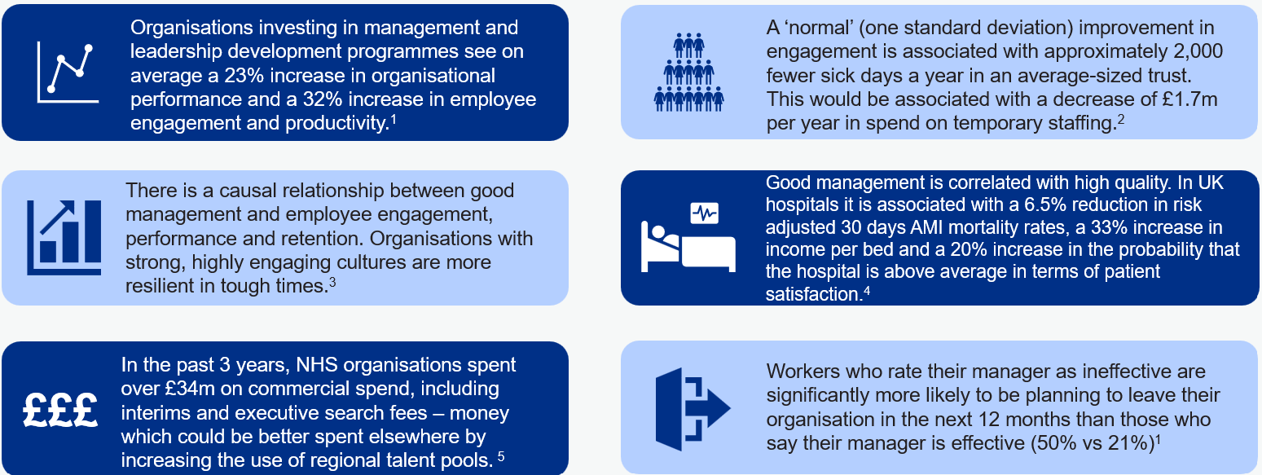
Investment in leadership and management enables the delivery of NHS priorities
Successfully delivering NHS priorities (e.g. reducing the elective backlog, achieving financial efficiencies and increased productivity) will require strong leadership and management at all levels.
Delivering the 10 Year Health Plan will depend on the abilities of leaders and managers to identify and implement initiatives to improve NHS services and successfully deliver the three shifts.
References:
¹ Chartered Management Institute
³ Gallup
⁵ Board Vacancies and Commercial Spend survey, NHS England
² Dawson and West, 2018
⁴ McKinsey & Company

Slide 7
Socialisation Phase Overview
Aims:
To explore how organisations implement (or plan to implement) the Framework, within either existing or new products and processes
To identify the benefits, challenges and obstacles relating to this experience, so that the learning can be shared with all other organisations
To gather feedback and advice from organisations to help in the development of practical resources and materials to accompany the framework launch and support implementation
Outcomes: Socialisation of the draft code and standards with c180 organisations has established:
Formal insights via the surveys provide robust data including what is in existence, how organisations plan to use the Framework and feedback on products such as the beta microsite, user guidance and personas to support future implementation
A number of examples of early preparation for implementation have already been developed and in time further case studies will emerge
Sharing of helpful resources such as a mapping template for existing materials, an implementation checklist and other useful resources which will continue to build over time to support uptake
Now the Framework has been launched we will continue to work with organisations in implementation and move this phase into a practical community of practice to enable high uptake and strong alignment with the new standards across the service

Slide 8
Thank you
Contact us:
England.LeadershipandManagement@nhs.net
Notes:
Standard title slide

