Slide 1


The perfect conditions for unconscious bias? How COVID-19 could lead to less inclusive practices
Dr. Doyin Atewologun, Director
DoyinA@deltaalphapsi.com
@DrDoyinA
CONTACT:
info@deltaalphapsi.com
+44 (0) 330 133 0587

Slide 2
Overview
Bias
  What it is
  Rooted in heuristics
  Everyday bias in our work lives
COVID-19 and bias
  Perfect conditions
  Impact on colleagues and staff
Beating bias
  Bias as a habit
  Some immediate actions

Slide 3
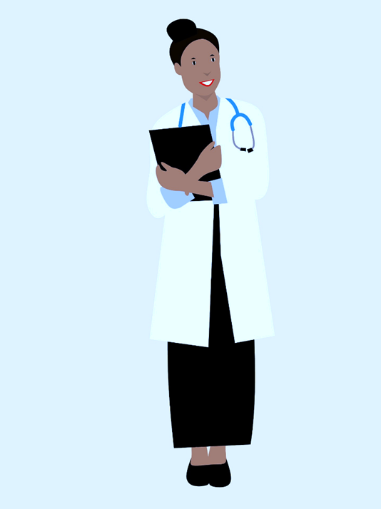
Remember this?
A father and his son were involved in a car accident in which the father died and the son was seriously injured. The son was taken by ambulance to a nearby hospital and was immediately wheeled into an emergency operating room. A surgeon was called.
Upon arrival, and seeing the patient, the attending surgeon exclaimed, ‘Oh my God, it’s my son!’

Slide 4
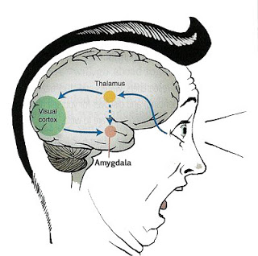
Bias is an error of judgement
“Bias is a limitation in objective thinking that is caused by the tendency for the human brain to perceive information through a filter of personal experiences and preferences”

Slide 5
Bias comes from our overreliance on heuristics
Representativeness
Overestimate based on similarity
Availability
Make decisions based on recall
Anchoring
Influenced by starting point
“Short-cuts or rules-of-thumb that help us to make decisions efficiently under uncertainty”

Slide 6
Everyday bias in our work lives
Counter-factual alternative
Halo vs. horns effect
Affinity bias
Self-serving bias
False consensus
Confirm-ation bias

Slide 7




COVID-19: the perfect conditions for bias
Multi-disciplinary outputs
Fact vs. fiction?
Personal and societal implications
What does all of this mean?
Rapidly-developing situation
How can I act quickly?
Information overload
What do I remember?

Slide 8
The potential impact on colleagues and staff
Our biases are most likely to affect those perceived as “different” to ourselves. This is because:
We subconsciously perceive difference as unfamiliar and uncertain
  Rely on heuristics (which lead to biases) to fill in gaps in our knowledge or understanding
We subconsciously perceive similarity as familiar and certain
  Heuristics have less impact because we remember things about ourselves and similar others
This means that underrepresented colleagues and staff are most likely to be the targets of biased decisions and actions
Bias can affect the psychological and physical resources needed most in a time of crisis, including:
Access to information
Sense of belonging
Perceptions of procedural and distributive justice/ fairness

Slide 9
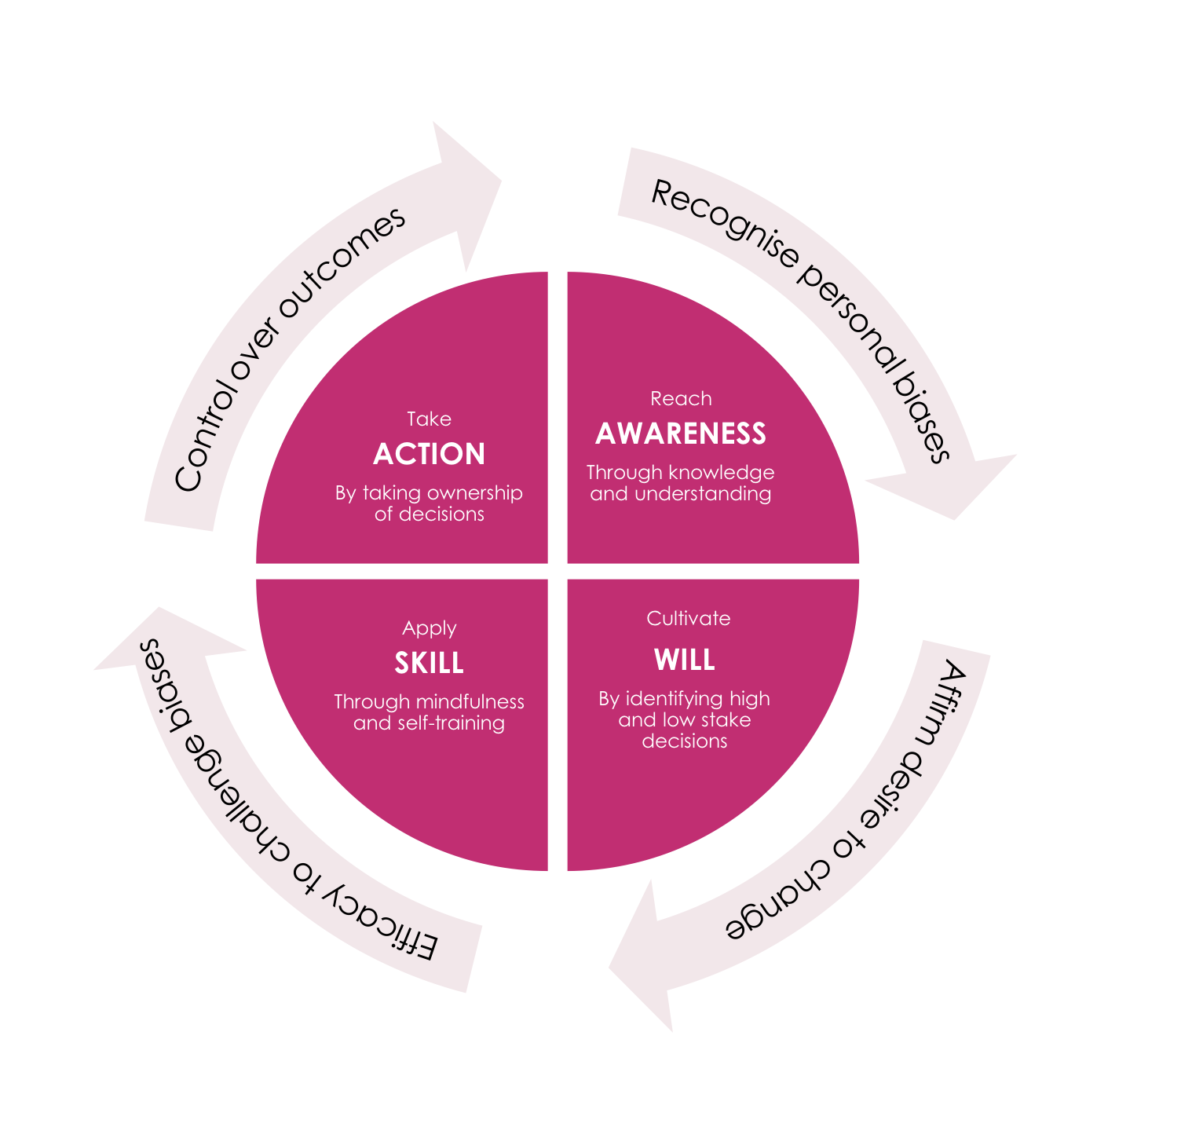
Think of bias as a habit
In the longer term:
Become aware of the biases you are most susceptible to
Decide whether you want to tackle them
Identify and apply methods for reducing/ removing them
Keep practicing those methods until you have formed a new habit

Slide 10



Things that you can start doing now
Be aware: conduct a self-audit of how you interact with others and make decisions – what assumptions are you making?
Be mindful: mindfulness is an evidence-based technique for reducing bias – you don’t need to meditate, just practice being in the present.
Be open: perspective-taking can highlight the pitfalls in your own thinking – what do others think and importantly, why?

Slide 11
Our work is built on the pillars of: Inclusion & Diversity Combine the science of psychology & lived experience to create impactful, lasting change for businesses and people Rigorous design & methodology Evidence-based learning & growth journey which engages the business ‘ecosystem’ Cultural/Structural change Change and coaching solutions that stimulate authenticity and empower change agents at all levels Project management & tailored communications Our Project Management Office drives excellence in participant experience & business engagement | Contact us. Dr. Doyin Atewologun: doyina@deltaalphapsi.com | 07941 231 395 Delta Alpha Psi: www.deltaalphapsi.com info@deltaalphapsi.com | 0330 133 0587

