Slide 1
Welcome to the
‘Supporting our Working Carers in the NHS’ webinar
10.00-11.45am, Thursday 4th February 2021
We will be starting shortly. Please feel free to read and reflect on this case study in the meantime…
#OurNHSPeople #ThinkNHSCarer
I stood nervously outside my manager’s office, clutching my envelope containing my resignation from being a midwife, I took a deep breath and knocked. I can’t believe it had come to this, I was leaving a job I loved, a profession I have dreamed off because I felt I could no longer cope with work and caring for my son. My son, Jack (name changed) has bipolar and I was his primary carer, I made sure he attended all his appointments and reviews, took his medication, provided emotional support when he was suicidal and helped him clear of his debts when he has spent £1000’s on credit cards or collected him from the police station after they had been called by a worried member of the public when he was manic. I was emotionally and physically drained. Constantly worried about my son and worried my performance in work was not as it should be. Worried I’d get into trouble for answering my phone on a shift, but worried if I didn’t Jack would become so anxious he’d spiral back into mania.
As I sat down my manager knew something was wrong immediately and as I handed her the letter she asked me what had happened. She sat quietly as I explained how I’d been struggling for months and had no choice but to leave. Telling her what I’d been going through, she was shocked. Not just because of the awful things that had happened but because I had not come to her. On reflection it had never occurred to me to ask for help, I was a mother and surely this was my job? My manager explained that around 20% of the NHS work forces are juggling working and caring and it was not something that I needed to do alone. In fact there was loads of support available for people in my situation. She told me about the working carers passport and explained how this would help me to think about things that would help me balance work and care. She told me about the page on the staff intranet site for working carers and gave me the access code for Employers for Carers Digital Resources. I felt like a weight had been lifted off my shoulders.
Six months later I am writing this after a shift as a midwife. My son is still ill, and I’m still his primary carer, that will never change. But things at work are different, a little bit easier. Most importantly I know I’m not alone and support is there for me.

Slide 2
Welcome!
Jane Galloway, Head of Flexible Working,
NHS England and NHS Improvement

Slide 3
Agenda
10.00-10.05am (5 mins) | Welcome Jane Galloway, Head of Flexible Working, NHS England and NHS Improvement
10.05-10.35am (30 mins) | Working carers in our NHS workforce Em Wilkinson-Brice, NHS Deputy Chief People Officer, NHS England and NHS Improvement (10 mins) Why supporting carers matters Jen Kenward, Experience of Care Lead, Community, Primary & Integrated Care, NHS England and NHS Improvement (10 mins) How support can be vital Dr Steven Cleasby, Clinical Lead, Unpaid Carers & Personalised Care team, West Yorkshire and Harrogate Health and Care Partnership (ICS) (10 mins)
10.35-10.50am (15 mins) | The Working Carer Passport and my journey Fatima Khan-Shah, Programme Director, Unpaid Carers & Personalised Care team, West Yorkshire and Harrogate Health and Care Partnership (ICS)
10.50-10.55am (5 mins) | BREAK
10.55-11.15am (20 mins) | How can we support our working carers? At an organisational and system level - Sharon Griffin, Senior Project Manager, Commitment to Carers team, NHS England and NHS Improvement (10 mins) Resources available - Juliet Andrew-Orji, Client Services Manager, Carers UK (10 mins)
11.15-11.20am (5 mins) | How to use ESR to signify working carer status and the Working Carer Passport Chris Moorley, Development Advisor, Electronic Staff Record
11.20-11.40am (20 mins) | Q&A
11.40-11.45am (5 mins) | Closing comments Jane Galloway and Jen Kenward, NHSEI
11.45am | Close

Slide 4
Working carers in our NHS workforce
Em Wilkinson-Brice, NHS Deputy Chief People Officer,
NHS England and NHS Improvement

Slide 5
Why supporting carers matters
Jen Kenward, Experience of Care Lead,
Community, Primary & Integrated Care,
NHS England and NHS Improvement

Slide 6
Why support is vital
Dr Steven Cleasby, Clinical Lead,
Unpaid Carers & Personalised Care team,
West Yorkshire and Harrogate Health and Care Partnership (ICS)

Slide 7
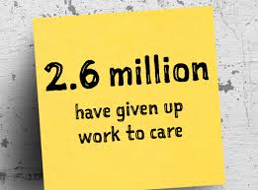

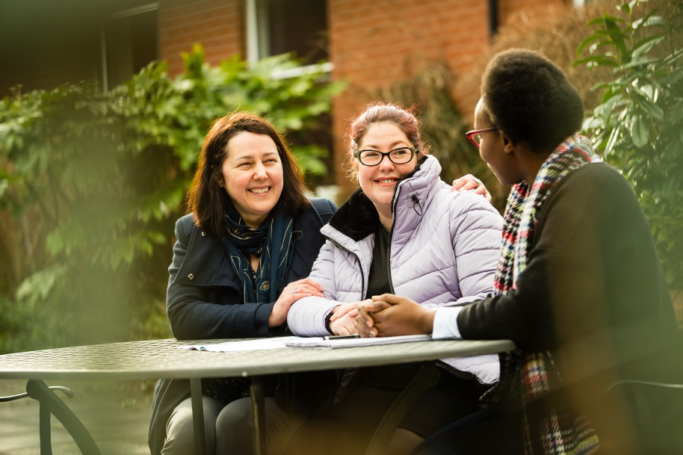
Working Carers Passport
February 2021
Fatima Khan Shah
Programme Director
WY & H Unpaid Carers and
Personalised Care Programme

Slide 8

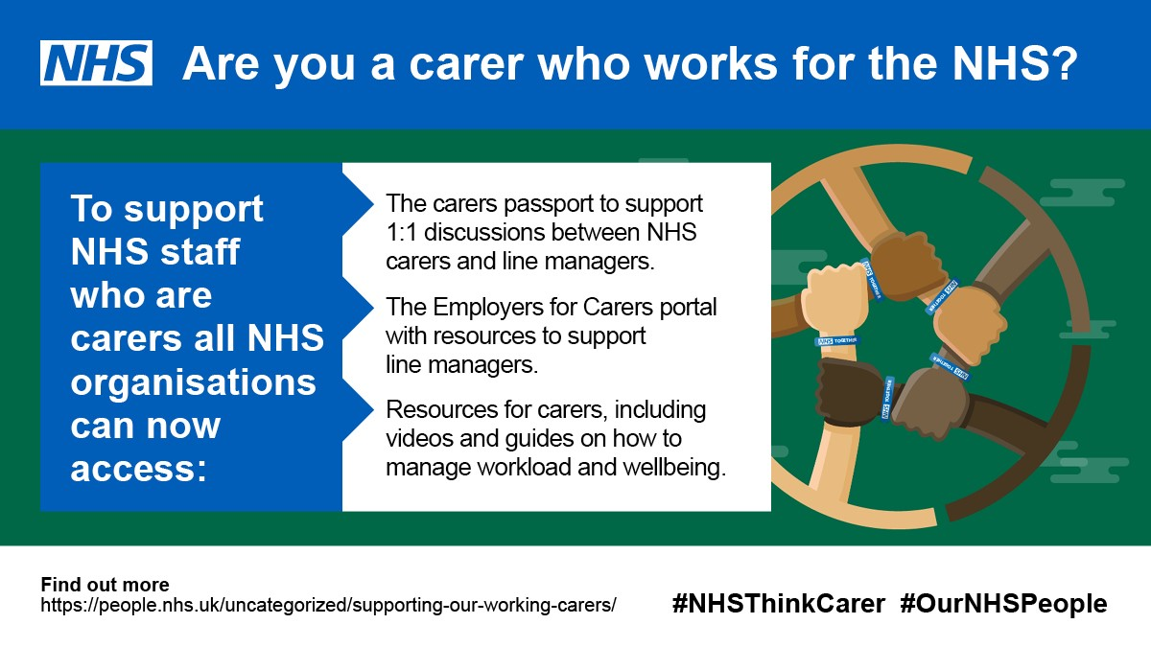
Our Ambition
Our ambition was to harness the NHS’s greatest strength, its people. 1 in 5 of our workforce are currently balancing working and caring responsibilities, we wanted to ensure that working carers felt more supported, valued and listened to.

Slide 9
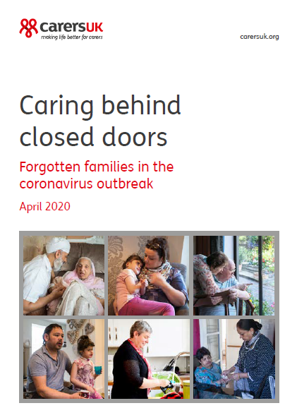
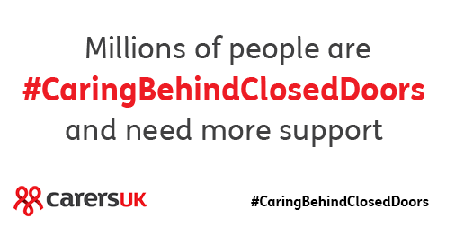
Caring behind close doors during Covid 19
Many carers are now providing more care than they have done ever before and that the need of self isolation or shielding with the addition of the closure of local services and reduced support have had a particularly powerful knock on effect for our carers. The report from Carers UK, highlights a number of other areas of concern including the following:
70% of carers are providing more care due to the outbreak
35% of carers are providing more care as a result of local services reducing or closing
Carer's are on average providing ten additional hours of care a week
69% of all carers are providing more help with emotional support, motivation, or keeping an eye/ checking in on the person they care for
81% of carers are spending more money, with 72% spending more on food and 50% were spending more on household bills

Slide 10
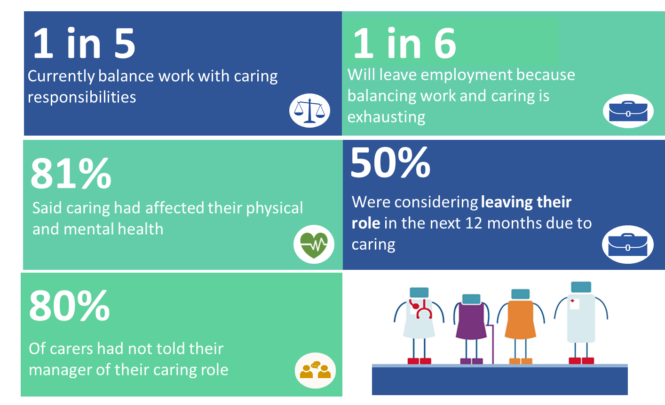

Slide 11
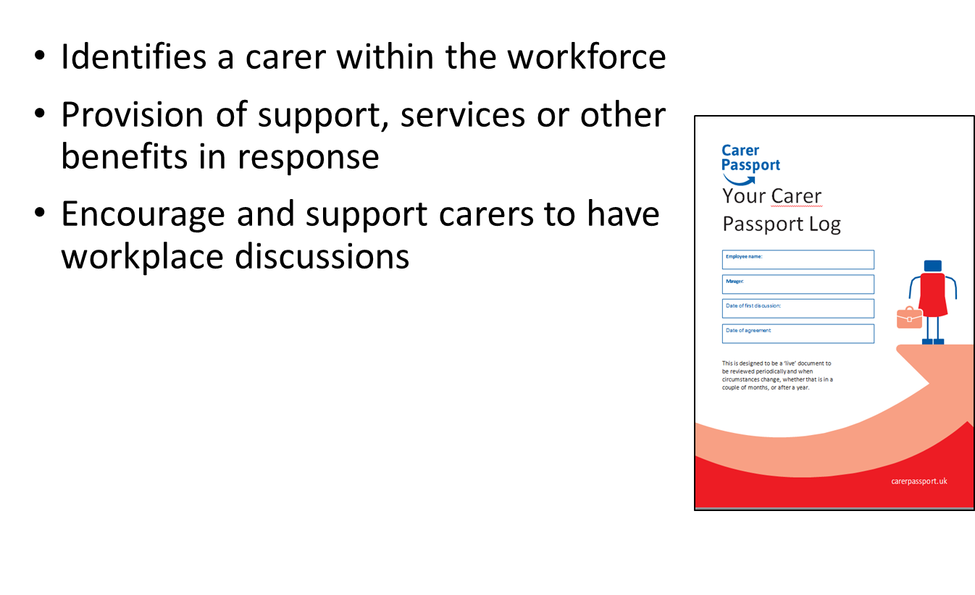
Aims of the passport

Slide 12
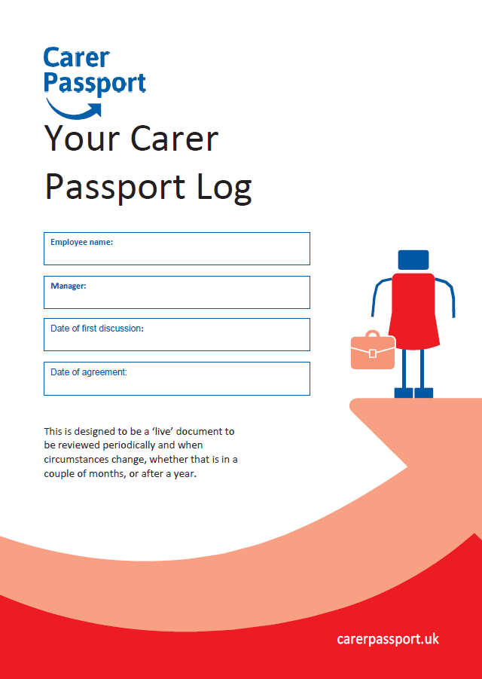
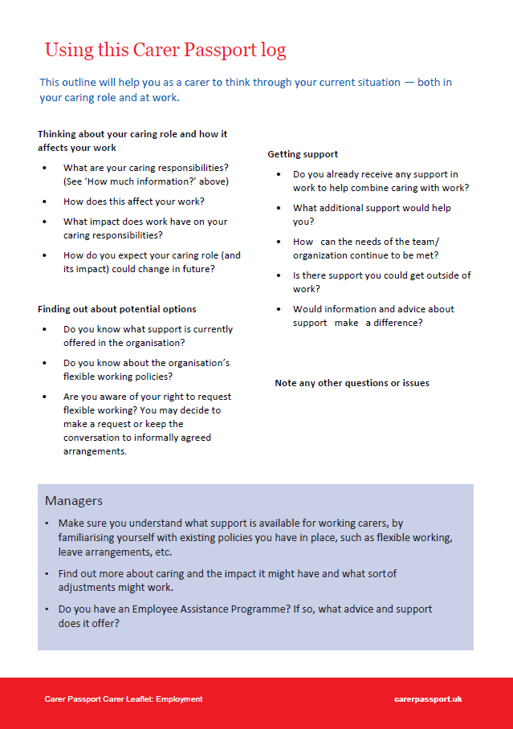
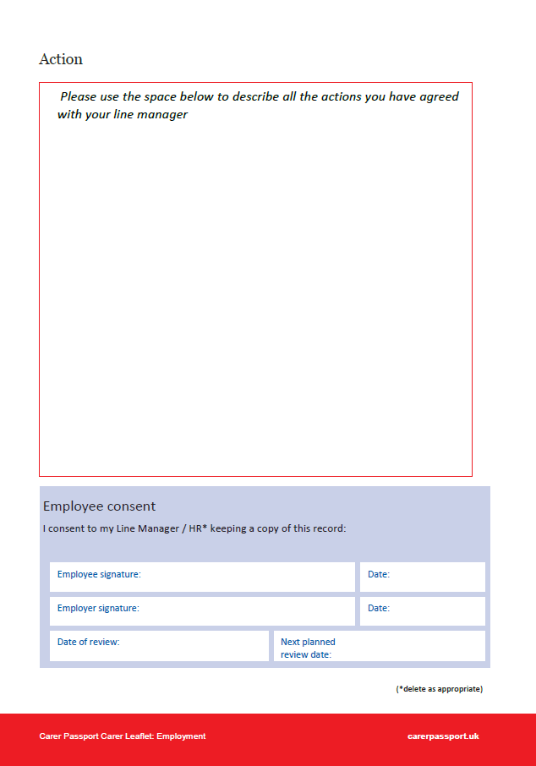
Working example

Slide 13

Adoption of the working carers passport
All local hospital trusts were invited to join a central project team.
The outcome was to secure adaption of the working carers passport from all six acute trusts
Potential reach is 11, 200 working carers across WYH.
Adaption of existing HR systems and processes were essential to achieving a successful outcome
WYH
Partnership
HCP
VCS
Carers
Place

Slide 14
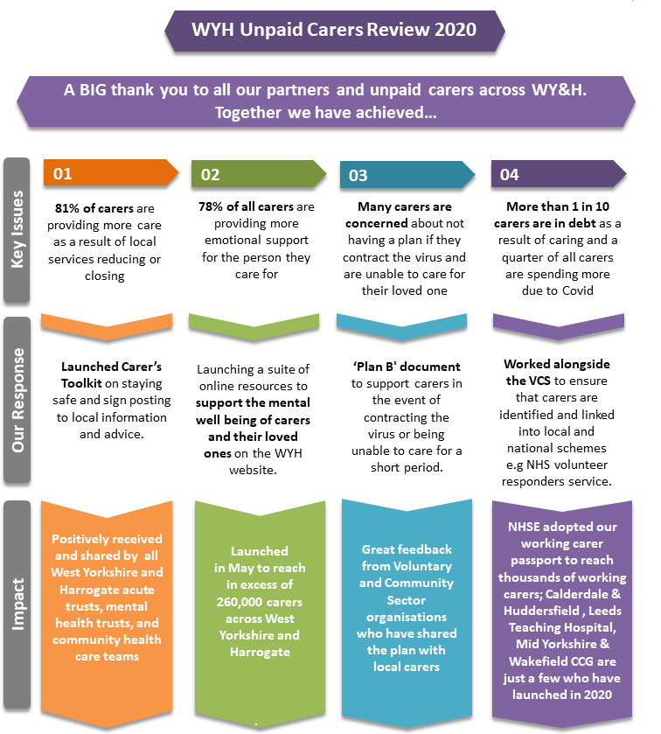
Outcome of the project
NHSE & NHSE in their response to the pandemic highlighted the working carers passport as a key focus.
WYH HCP introduced two new competencies into the NHS Electronic staff record system to enable employees to be identified as working carers and determine if they were holders of a passport.
WYATT and mental health trusts adoption of the passport has secured national recognition by NHS within their 2020 NHS People plan with the passport set to reach 56,000 working carers across the NHS.
Employee for carers membership adopted by all six places.
Shorlisted for a HSJ Workforce Initiative Award 2021
Notes:
All local hospital trusts were invited to join a central project team which worked collaboratively to implement solutions for working carers. An initial outcome of the project was to secure adoption of the working carers’ passport from all six acute trusts across West Yorkshire and Harrogate which was successfully achieved in 2019. All trusts are now working tirelessly to support their working carers and three hospital trusts and a CCG have already successfully launched the passport across their local workforce.
Adoption of the passport will reach in excess of 11,200 working carers across all six NHS acute trusts to retain their staff and improve wellbeing and resilience over the longer term. Organisations who have implemented the Working Carers Passport and case studies of working carers who have benefited from passports have been extremely positive, with feedback including a reduction in unplanned leave, stress levels and attrition.
In order to reach as many working carers as possible within NHS organisations, adaption of existing HR systems and processes was pivotal to achieving a successful outcome. Identifying and supporting working carers, particularly with the additional pressures of responding to the COVID-19 pandemic, was a key focus of the NHS England & Improvement and Employers for Carers campaign to highlight the Working Carers Passport scheme. WY & H HCP were successful in introducing this initiative involving two new competencies into ESR, an NHS HR system which can be assigned to employees either by themselves, by managers or their HR team. Using competencies allows HR managers to efficiently utilise existing functionality to enable employees to identify as a working carer or a holder of a working carer passport. Managers and HR teams can then work to ensure the support needed is available to them.
The success of the project with WYATT and mental health trusts has been significant and has secured national recognition by NHS England who decided to adopt the initiative as a national campaign in June 2020 for all trusts to implement a working carers passport to reach 56,000 staff. The recognition of the importance of this work with working carers was also echoed in the inclusion of a Working Carers Passport within the publication of the NHS People Plan in 2020.
Other successful outcomes to support working carers have included adoption of the to Employers for Carers membership by all of our six local areas to support working carers within those organisations.

Slide 15
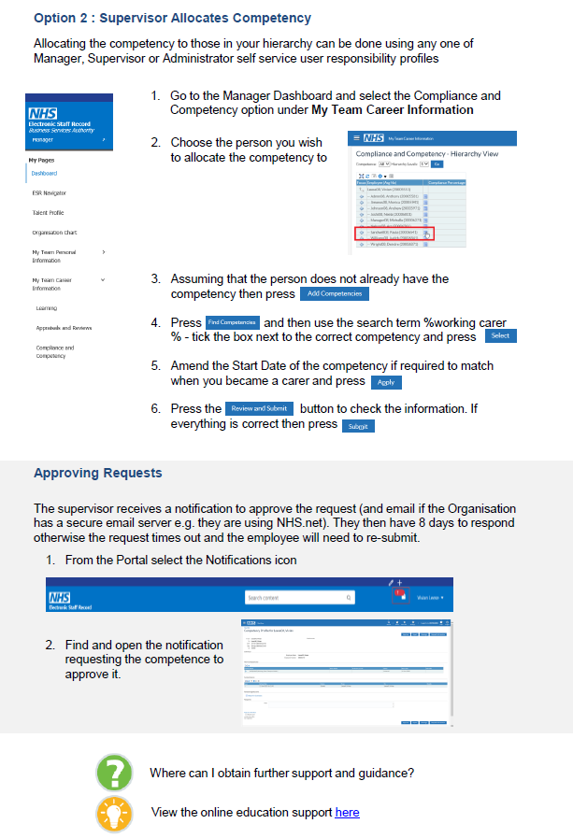
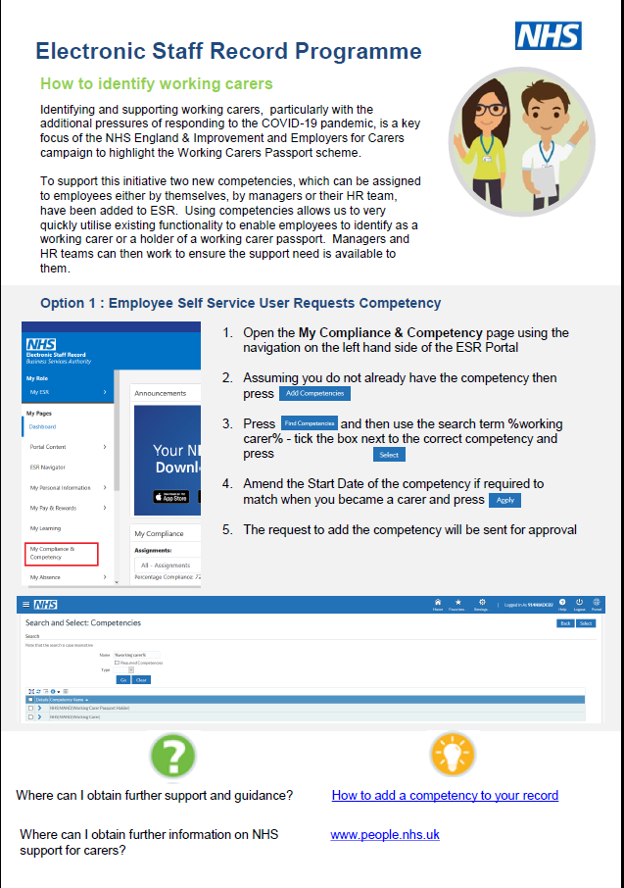
Adoption by NHSE into the NHS ESR HR system

Slide 16


















Slide 17














Slide 18
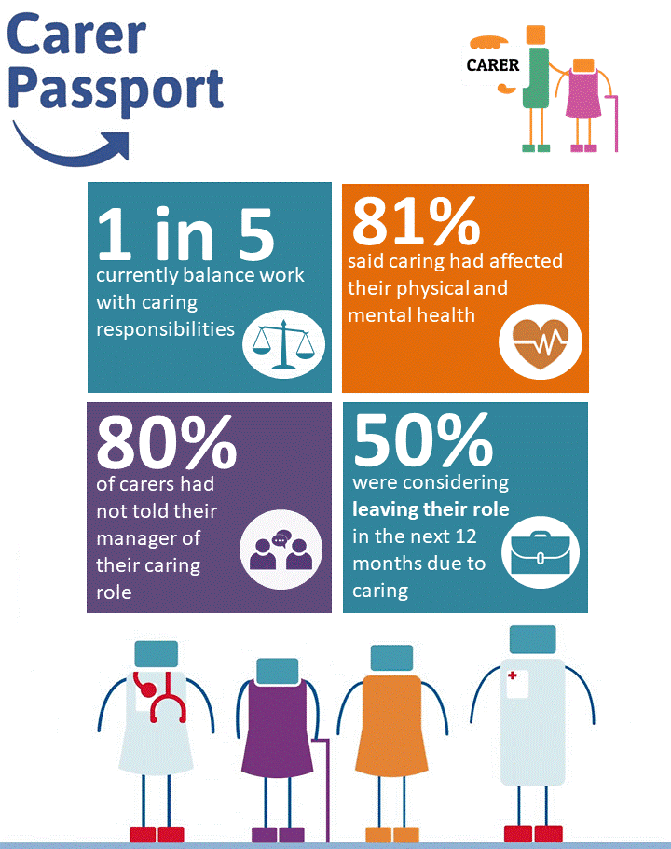
Scale and spread
Introducing the initiative to local mental health trusts, community trusts, local councils and clinical commissioning groups (CCGs).
WY & H HCP recruited a project manager to lead the working carer’s project who had a pivotal role in influencing the adoption of the plan across our local system
Development of central resources transferable across the organisations, enabling these resources to be scaled up by NHSE to support the national launch of the working passport.
By working collaboratively the team reduced workload, increased efficiency and delivered a consistent and equitable approach for working carers including shared best practice, lessons learned and transferable resources
The project team has worked to ensure there were strong links with voluntary carers’ organisations to maximise support and support wider adoption across WY&H footprint including CCG’s & local authorities who have invested in the umbrella resources for the whole footprint
Notes:
The intention of this project was to transcend organisational boundaries by creating equity across our health and care system, introducing the initiative to local mental health trusts, community trusts, local councils and clinical commissioning groups (CCGs). By engaging with different stakeholders across the partnership, including the local workforce action board, NHS trust boards, clinical forums, the urgent and emergency care program, primary care programme, mental health programmes, the workforce programme, the cancer programme and community pharmacies we have put the working carers agenda front and centre of the partnership.
To support the spread and scale of the project, the WY & H HCP recruited a project manager to lead the working carer’s project who had a pivotal role in influencing the adoption of the plan across our local system starting with NHS Trusts. The approach included the development of central resources transferable across the organisations, enabling these resources to be scaled up by NHSE to support the national launch of the working passport.
By working collaboratively the team reduced workload, increased efficiency and delivered a consistent and equitable approach for working carers including shared best practice, lessons learned and transferable resources. The project team has worked to ensure there were strong links with voluntary carers’ organisations to maximise support with future plans to support wider adoption across WY&H footprint including CCG’s & local authorities who have invested in the umbrella resources for the whole footprint including NHS providers

Slide 19
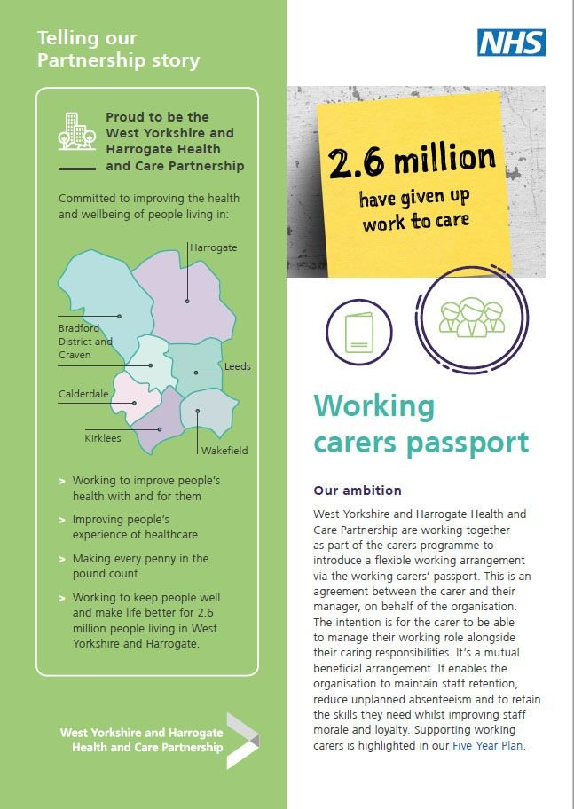
The secret to our success
Support from the top
Governance
Red spreadsheets
Champions at all levels
Sharing our homework
Healthy competition
Demonstrating Impact

Slide 20

Carer friendly cultures
Dawn Parkes, Deputy Director of Nursing at The Mid Yorkshire Hospitals NHS Trust, said: “We recognise the challenges carers can face, who often haven’t recognised themselves as carers and therefore haven’t sought support. The hospital setting provides us with a window of opportunity to reach out with that support. As well as offering carer friendly spaces and accessible information, we also have systems in place to support working carers, including a regular forum providing opportunities for working carers to meet to get peer support and discuss issues which are important to them.”
Mid Yorkshire Hospitals NHS Trust and Wakefield Council have developed carer friendly spaces in hospitals so that carers have access to up to date information, comfortable areas where they can get information, support and meet with relevant professionals about the care/treatment of their loved ones – an important area they want to share wider across the district.
Carers are encouraged to share their views on what they would like to see in hospitals and work is underway to involve unpaid carers to develop a ‘Carers Charter’ for Mid Yorkshire Hospitals NHS Trust.

Slide 21
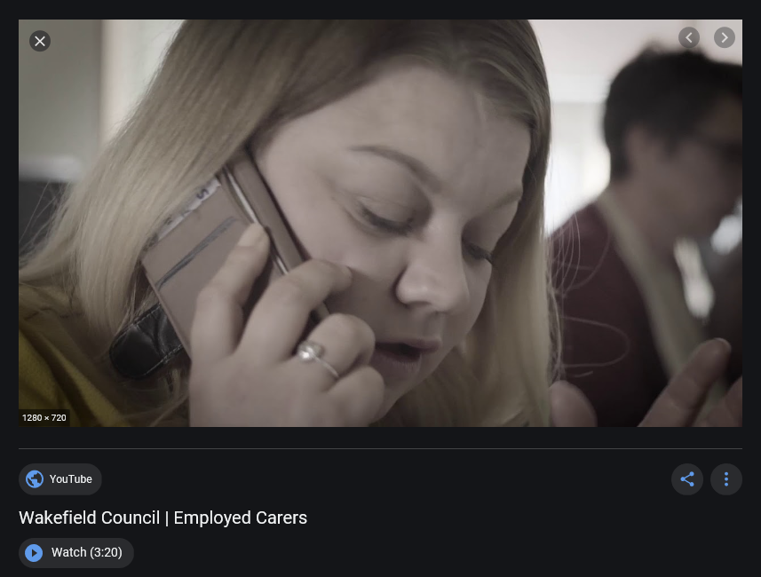
A day in the life of a working carer
https://www.youtube.com/watch?v=OS-nhuRz1uA (3 mins 19 secs)

Slide 22
Next steps…
In the pipeline for 2021
  Information and advice for carers looking after a loved one coming towards the end of their life
  Resources to support our partners to allay fears within the carer's community about utilising health and care services such as domiciliary and community care​
  Identifying digital resources to support our young carers.
  Working with NHS employers to launch a national version of working carers passport for all trusts in England
What our people saying about the WYH working carers passport?
The carers passport has been useful as it helped me and my manager look at ways to help me without me feeling I was letting the service and colleagues down. I am now working 30 hours a week and my manager will rota me on around appointments when possible so I don’t have to use all my annual leave.
Pharmacist
I am a carer to my Mum with dementia and have two teenagers. This last year has been stressful and I have used both annual leave days and sickness to cope with looking after them. My Manager said I could work some time back but when you are stressed and exhausted this is not always an option. The passport has given me and my manager an opportunity to have a good discussion about my responsibilities and needs and what can be put in place to support me and the service.
Clerical Officer
“I’m a carer for my son who has autism I also work as a midwife. Combining the two is often impossible and I’ve often thought about leaving my job even though I love it. The working carers passport is a godsend. It helped me to really think about where I could do with additional support . I talked with my manager and we found things that would help. The fixed shifts have really made a difference and me and my son are much happier. NHS Midwife and working carer

Slide 23
5 minute break

Slide 24
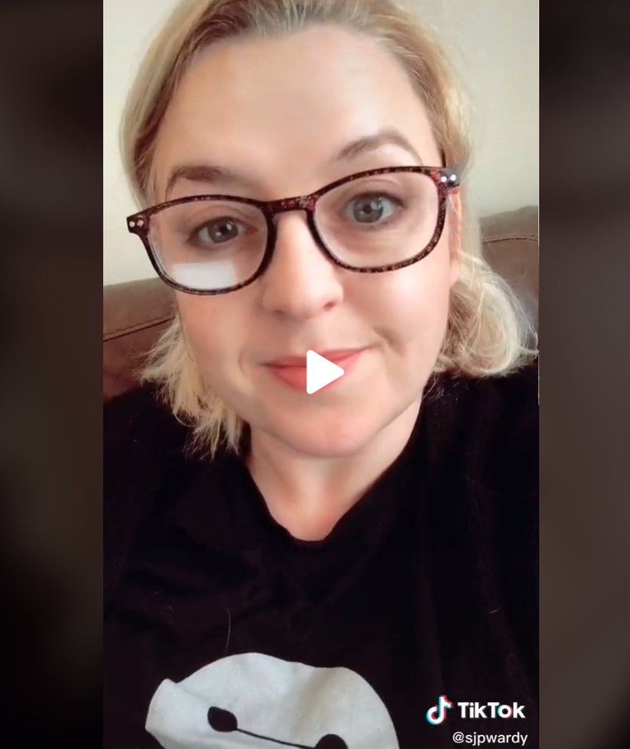
How can we support our working carers?
At an organisational and system level
Sharon Griffin, Senior Project Manager, Commitment to Carers team, NHS England and NHS Improvement
Tik Tok video about the value in joining a Carers Network
(55 seconds)

Slide 25
How can we support our working carers?
Resources available - Juliet Andrew-Orji,
Client Services Manager, Carers UK

Slide 26
Identifying our working carers using ESR
Chris Moorley, Development Advisor, Electronic Staff Record

Slide 27
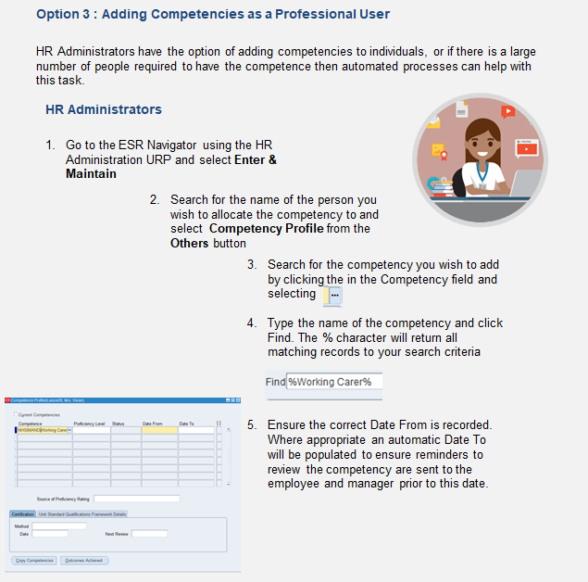
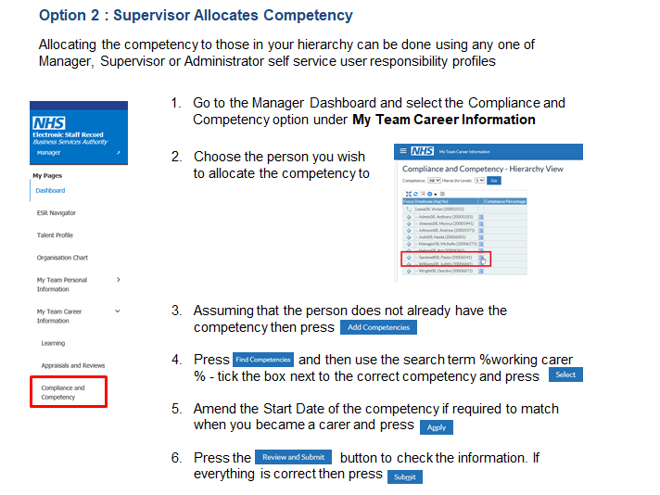

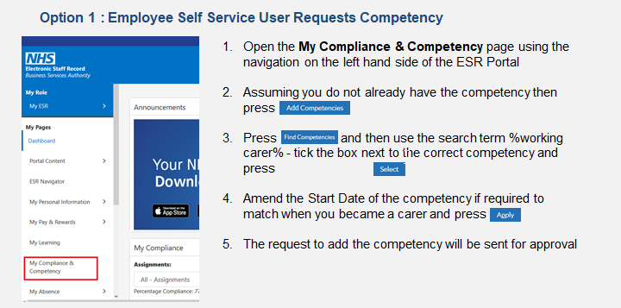


Slide 28
Q&A
Please submit any questions you may have in the MS Teams chat box

Slide 29
Closing comments
Jane Galloway and Jen Kenward
NHS England and NHS Improvement

Slide 30
THANK YOU!
Visit https://www.england.nhs.uk/supporting-our-nhs-people/how-to-guides/supporting-our-working-carers/ to find out more about the resources available to support you as a working carer, as a line manager of a working carer or as an organisation.
#OurNHSPeople #ThinkNHSCarer

