Slide 1
The power of procurement NHS as a driver of industrial strategy
Dr Tom Lloyd Goodwin
Director of policy and practice
@tomlloydgoodwin
@CLESthinkdo

Slide 2
Plan for today
Intro to CLES
Anchors 101 – why do anchors matter ?
Procurement case studies – what’s happening right now, what’s the art of possible?
Discussion – powering up procurement in your health systems

Slide 3
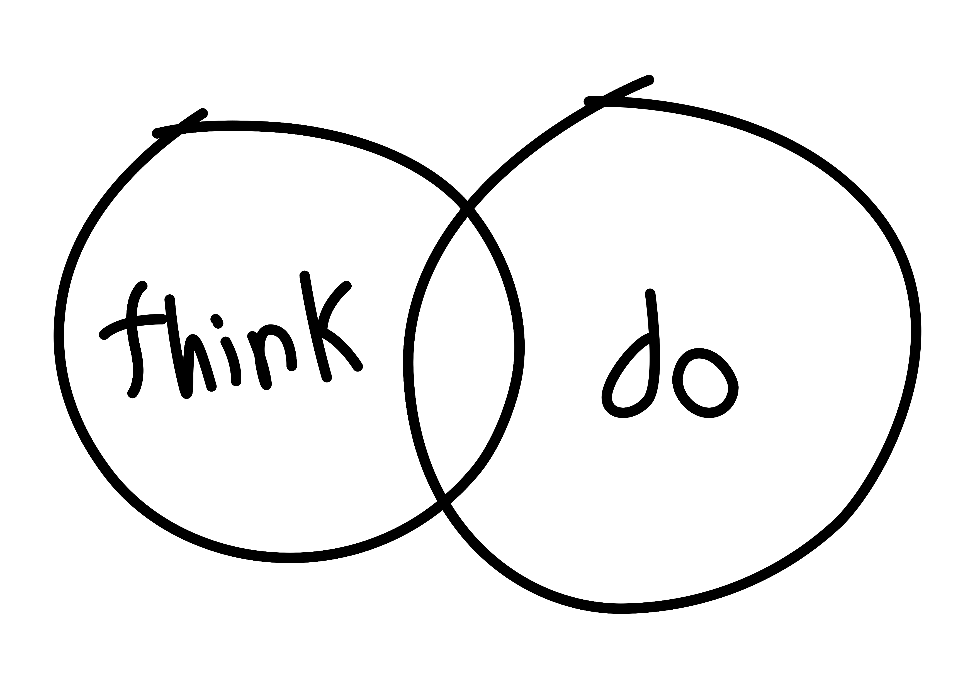
About CLES
The national organisation for local economies
Progressive economics for people, planet and place
Thinking and doing, to achieve social justice and effective public services

Slide 4
Introductions

Slide 5
Anchors 101
What’s it all about?
Why do anchors matter?

Slide 6
The power of anchor institutions
Local government
The NHS
Universities and colleges
Housing associations
Some Large private businesses…

Slide 7
Community wealth building
Community wealth building is a progressive approach to economics and economic development.
A set of guiding principles to help us build a more inclusive economy.
It seeks to change the way that our economies have come to function by aiming to retain more wealth and opportunity for the benefit of local people.
Notes:
What is community wealth building?
Community wealth building is a progressive approach to economics and local economic development.
It’s a set of guiding principles to help us build a more inclusive economy.
An economy where more wealth and opportunity are retained and recirculated for the benefit of local people.
This is in contrast to our current economic model…

Slide 8
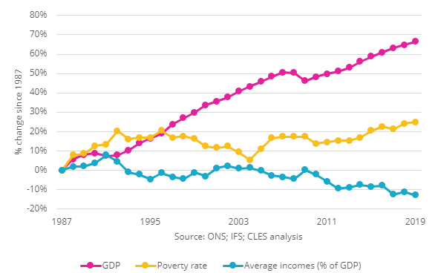
An antidote to the current growth problem
It’s not a given that even if your economy grows (as measured by GDP) that all people will benefit.
While GDP has increased, incomes have fallen and poverty rates have climbed.
This means that wealth is not benefitting the communities that create it.
Notes:
This graph shows us UK GDP growing to 2019 (the pink line) mapped against a declining average income (the blue line) and an increasing rate of poverty (the yellow line).
So, in short – the economic growth we’ve seen is exclusive – it does not benefit everybody.
Here’s some stats to illustrate;
• In the UK, the five richest families own more wealth than 13.2 million people.
• Over the last ten years the number of billionaires in the UK has almost doubled and the wealth of the UK’s billionaires has more than doubled.
• The richest 1% of people in the UK own the same wealth as 80% of the population, or 53 million people.

Slide 9
But it doesn’t have to be this way..
CWB and anchor activity can drive positive health and wellbeing impacts
Improvements in mental heath, life satisfaction and wages
Peer reviewed evidence
Notes:
In terms of the evidence base for this.. CLES were co-investigators on an NIHR study – looking at the health and wellbeing impacts of the community wealth building interventions that are being used in Preston
What we’ve found here in Preston compared to 12 other matched control areas is improvements in mental heath, life satisfaction and wages.
These findings have just been published in the Lancet,
[ADD LINK TO MJ ARTICLE]

Slide 10
In practice
Why does this look like on the ground?

Slide 11
There are challenges around a different approach to NHS procurement
“[NHS] procurement systems across the UK have been designed to produce certain outcomes [namely, generate savings] with no targets around progressive procurement practice”.
“almost mandated to use national frameworks to buy most consumables”
“very much governed by cost and efficiency”.

Slide 12
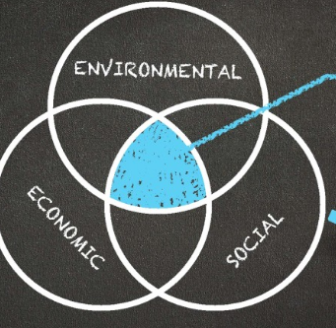
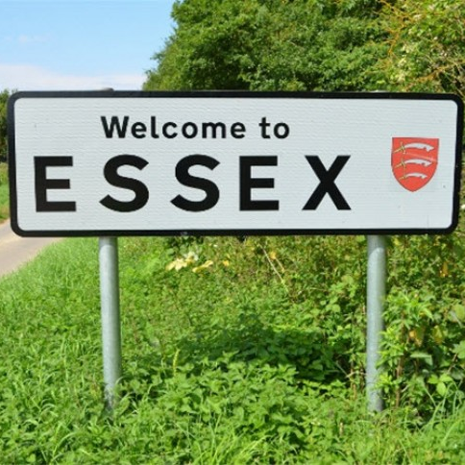
Social value frameworks
increase sustainable employment,
increase skills levels,
improve chances for young people and
reduce Co2 emissions

Slide 13
Support for local enterprise

Slide 14
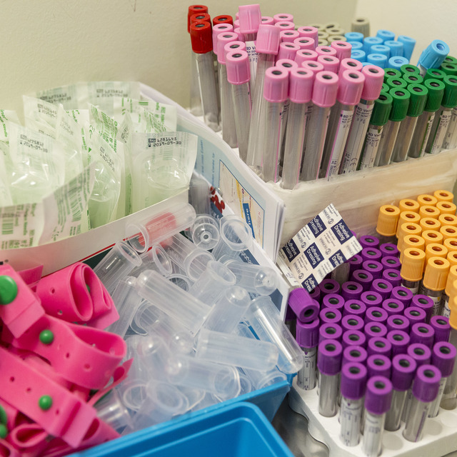
The art of the possible?
£6bn spent on consumables each year
NHS is challenged by Brexit, net zero requirements and obligations around economic development
Why ship-in single-use products from oversees?
We couldn’t make and supply them from the UK instead…?

Slide 15
New local industrial strategies
NHS and local government working together
Identifying potential capacity in local businesses
Establish new local manufacturing offer for the NHS
Explore re-use not single use
ICSs footprints could provide a forum to explore these ideas

Slide 16
Any questions…?

Slide 17
For discussion
How does what we’ve outlined resonate?
What are the challenges?
What other opportunities are there?
Where could you start?

Slide 18
Thank you!

Slide 19
Get in touch
0161 236 7036
laurenbond@cles.org.uk
Tomlloydgoodwin@cles.org.uk
@CLESthinkdo
www.cles.org.uk

