Slide 1
HWB Stocktake Update Psychological and Emotional HWB Provision: South East Region 14 April 2020 Alison Jennings / Helen Edmunds

Slide 2
Summary
In response to COVID 19 we are working in close collaboration with organisations across the NHS to ensure appropriate health & wellbeing (HWB) support is in place and functioning effectively
To determine the current state of HWB provision we conducted a rapid COVID-19 Health & Wellbeing Stocktake from 4-8 April with NHS organisations primarily focusing on Trusts but with some responses from CCGs and others (County Council; Hospice)
The south east organisations (44) who have participated in this Psychological and Emotional HWB stocktake have provided responses which look at:
Promotion of the national HWB offers
Access to local psychological/ emotional support over a range of subcategories
Local enhancement of the Employee Assistance Programme (EAP)
Local bereavement support
Local listening services
Decompression support
Health and wellbeing rooms/ spaces
Local wellbeing apps
Local intranet site/ HWB portal
Local resilience coaching
Access to chaplaincy / faith rooms
Enhanced chaplaincy / faith support
Other forms of psychological support

Slide 3
Summary (2)
3. Creating a sense of belonging
4. Psychological preparation for returning staff and integration of this into induction
5. Communication of offers
The stocktake will remain open and the South East regional HWB lead will work with outstanding organisations to respond so that we reach 100% completion in the region.
The analysis of the data by region and STP/ICS will channel national and regional support to the areas of greatest need

Slide 4
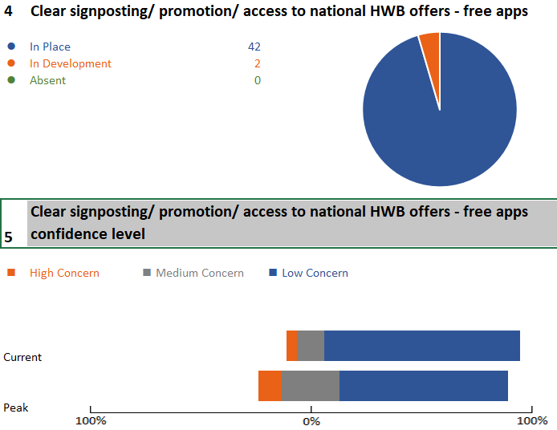
1. Promotion of the national HWB offers
All of the organisations in the south east are promoting or have plans in development to promote the national HWB offer and a significant majority are confident this will be satisfactory during the peak period. 4 organisations (acute trusts) in the south east have highlighted a high concern in their confidence level at promoting the national HWB offers at peak demand, which is where support from their respective HWB / workforce cell in their STP / ICS could provide support.

Slide 5
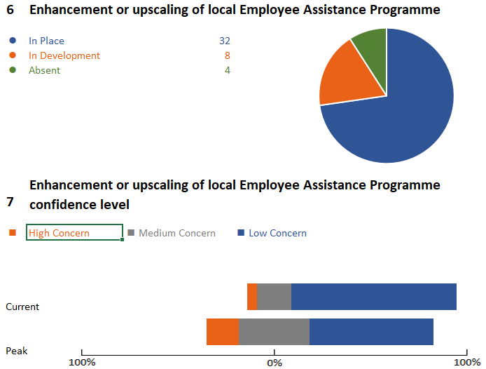
2a. Local enhancement/ upscaling of EAP
91% of organisations in the south east have either enhanced or are planning to enhance the provision of EAP services to local staff. The few organisations where this is absent are either CCGs, CSUs or other organisations where current service levels will be appropriate. 30% of organisations in the south east express medium concern that this enhancement may not meet needs during the peak period with 14% of organisations (6 ) expressing high concern.

Slide 6
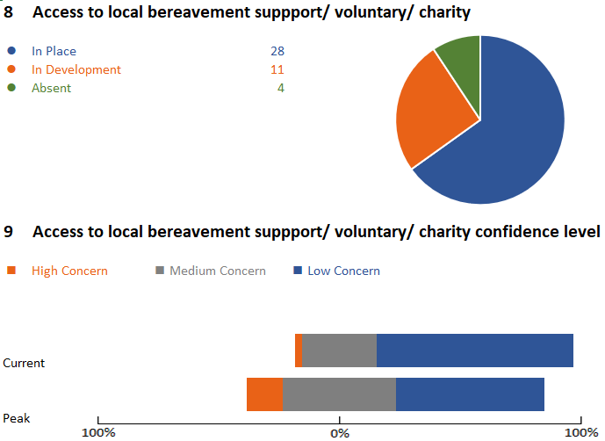
2b. Access to local bereavement support
65% of organisations in the south east have local bereavement support in place with a further 26% organisations with this in development for staff. However, 37% express medium concern and 12% (5 organisations) express high concern for this level of local support during the peak period. Access levels are also a concern for 28% of organisations currently.

Slide 7
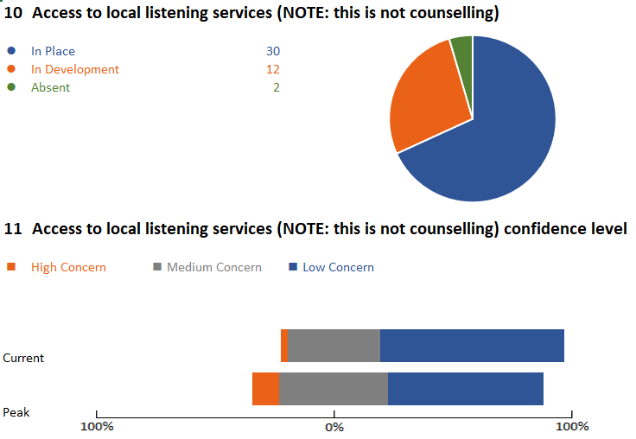
2c. Access to local listening services
68% of organisations in the south east have access to local listening services (not counselling) with a further 27% or organisations with this support in development. However, 45% of organisations express concern (medium and high) that this will not be sufficient during the peak period. 34% or organisations are concerned currently that local access is not sufficient.

Slide 8
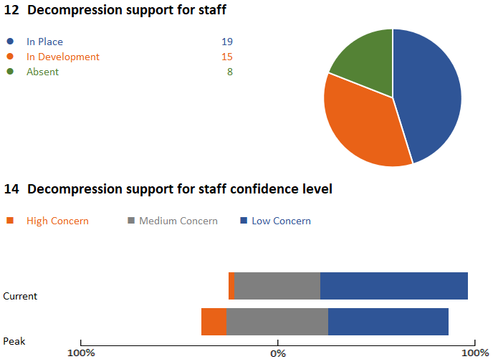
2d. Decompression support for staff
45% of organisations in the south east have decompression support in place for staff with a further 36% developing this offer. The 19% of organisations without this support may well map to organisations types such as CCGs or CSUs but this presents a risk to the people in these organisations for their longer-term wellbeing. 69% of organisations express medium or high concern for this support during the peak period.

Slide 9
2d. Decompression support for staff (2)
Examples of common local decompression support in place
Spaces: wobble rooms/ unwind rooms/ wellbeing hubs/ care cafes/ sanctuary spaces
Virtual spaces which provide similar chat/ peer support and listening services
Huddles and debriefs pre shift and post shift – many using structured processes and trained dedicated staff
Upskilling of line managers and shift supervisors to provide decompression support
Peer support networks / buddying
TRIM processes (Trauma Risk Management) or Critical Stress Management (CISM) practitioners
Restorative clinical supervision/ virtual supervision
Virtual Schwartz rounds
On-site wellbeing Chaplain / hospital chapel / multi-faith rooms
Manage your Mind - weekly online sessions
Use of Mental Health First Aiders
Trained ‘debriefers’ who have a dedicated role on shift
OH support, line manager support, psychological therapies support, HR advice and guidance
Deep listening events, coaching and mentoring, virtual tea breaks, virtual leaving/birthdays dos, virtual team chats
Mindfulness and resilience - online access and presentations during inductions for Junior doctors and upskilling training
Team Psychological Support session co-facilitated by a psychological therapist and a compassion champion

Slide 10
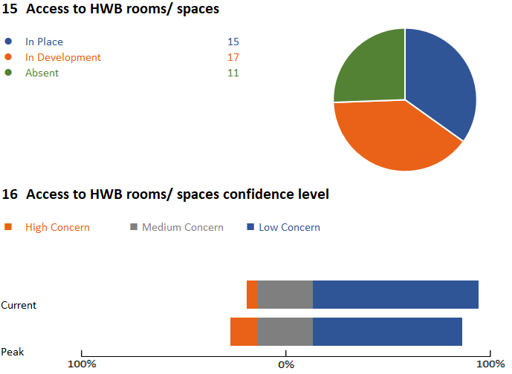
2e. Access to HWB rooms/ spaces
35% of organisations have access to HWB rooms/ spaces in place for staff with a further 39% developing this offer. The 26% of organisations without this support may well map to organisations types such as CCGs or CSUs but this presents a risk if this is absent in provider Trusts, particularly Acute settings. 35% of organisations express medium or high concern for this support during the peak period.

Slide 11
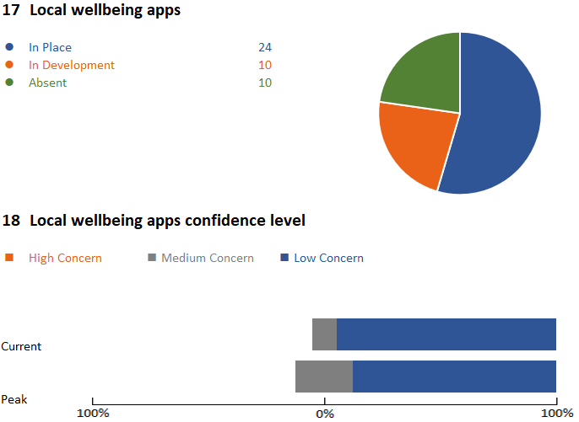
2f. Provision of local wellbeing apps
55% of organisations in the south east provide local wellbeing apps for staff with a further 23% developing this offer. 20% of organisations express medium concern for this provision during the peak period.
The use of these local apps versus the national apps would be useful to track if possible.

Slide 12
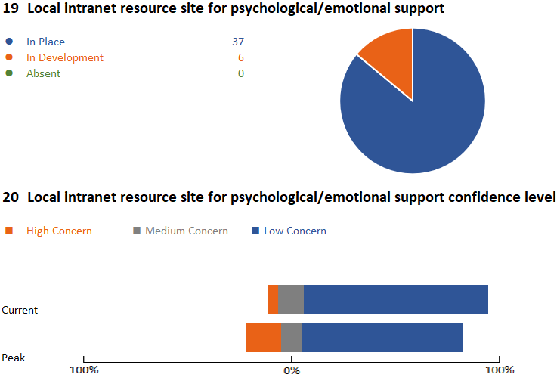
2g. Local HWB intranet
86% of organisations in the south east have a local HWB intranet site in place for staff with a further 14% developing this offer – so full coverage based on the current response rate. 26% of organisations express medium or high concern for this service during the peak period.

Slide 13
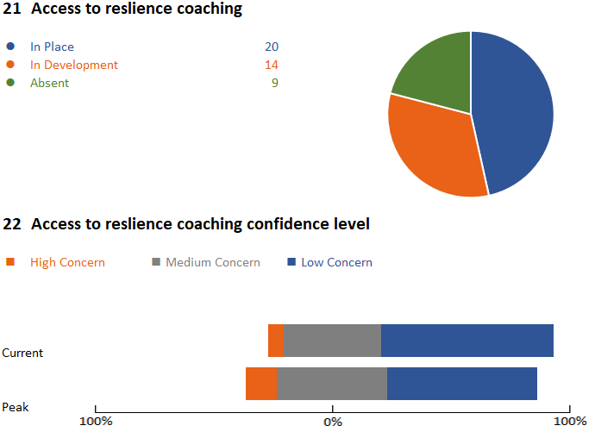
2h. Access to resilience coaching
47% of organisations in the south east have provided access to resilience coaching for staff with a further 35% developing this offer. The extent (staff groups who can access) or type of this coaching (one or more sessions/ duration etc) is unknown. 42% of organisations express medium or high concern for this support during the peak period.

Slide 14
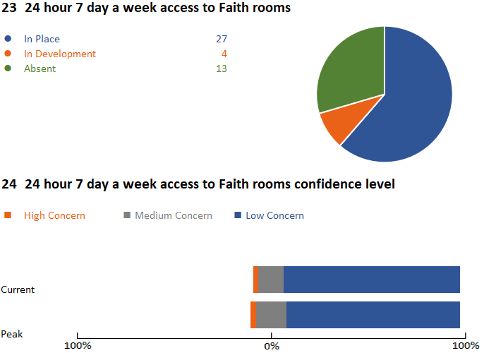
2i. 24-hour 7 day a week access to Faith rooms
61% of organisations in the south east have 24-hour 7 day a week provide access to Faith rooms with a further 9% developing this offer. The 30% of organisations without this support may well map to organisations types such as CCGs or CSUs but this presents a risk if this is absent in provider Trusts, particularly Acute settings. 18% of organisations express medium or high concern for this provision during the peak period.

Slide 15
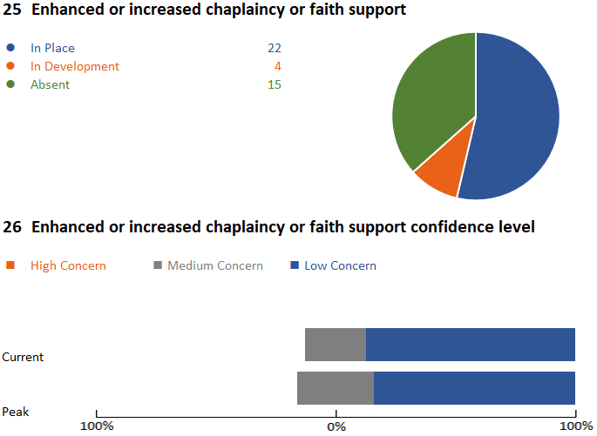
2j. Enhanced or increased chaplaincy or faith support
54% of organisations in the south east have enhanced or increased chaplaincy or faith support with a further 10% developing this offer. The 37% of organisations without this support may well map to organisations types such as CCGs or CSUs but this presents a risk if this is absent in provider Trusts, particularly Acute settings. 27% of organisations express medium concern for this provision during the peak period.

Slide 16
2k. Other forms of psychological/emotional support
Examples of other psychological/emotional support offers
Regular twitter and Facebook posts encouraging interaction, connection with others and sharing ideas and resources.
Workplace 'live' q and a with psychologist and 'special guests' within the pressure points
We have a dedicated one stop shop for staff wellbeing (11 full time staff ) - a fully resourced service providing access to in house mental health practitioners, physiotherapists and a support team who keep an up to date directory of services to signpost staff to
Managers WebEx 2 times a week for psychological support and advice
Adaptation of IAPT front end to enable 3-4 sessions of structured supportive listening for bereaved or otherwise traumatised members of the public (incl. NHS staff)
24-hour chaplaincy helpline. Chaplains visit wards where there has been a death to provide support for staff
Safe Space social media set up for sharing of support networks/apps wellbeing guides
TRiM process / referral to vetted therapists
Internal mental health team who also provide resilience training
‘Back-up-buddy’ app launched providing 24 hours access to support
Wellbeing boxes
NLP provision
‘Time to Talk’ leaflets attached to care packages
Managers guidance booklet on supporting staff post trauma & self help guide for trauma during and post pandemic
Access to single incident defusion package for teams/individuals,Buddy system for redeployed staff
Access to specialist advise/support for NHS families and children
Bite size training for managers via podcast and intranet materials to build and maintain emotional resilience and wellbeing in teams
Bite sized training (podcasts and materials) online for staff to help them support patients and families with anxiety, bereavement etc

Slide 17
3. Creating a sense of belonging
Examples of how organisations are creating a sense of belonging
Facebook pages – virtual communities with stories, thank you, video streams from senior leaders
Dedicated gratitude twitter hashtags
Gifts and thank you packs
Kindness posters, cards of gratitude, social media posts, compassionate leadership, donations of support and goods from the local community
Regular video from CEO / Exec / reflections for the day
Created a community on social media, Safe space. This offers peer to peer support, psychological support and the sharing of information, support networks, apps, information and wellbeing opportunities
We are about to start a hashtag based on 'holding the hope 2020' to link positive news throughout the crisis. Letters to all staff are planned, sent by CEO and Divisional CDs
We have a 'proud cloud' where people can post thank you messages to other staff
Remote working guides for managers and teams
MHFAs running virtual coffee mornings
Local volunteer group (staff) shopping / connecting with colleagues who are vulnerable
MS Teams regular briefings
HR updates and ‘stay well’ initiative
Team quizzes
Arts and crafts non-work activities to access
Salvation Army providing bacon sandwiches
Letter to all staff from the CEO – thanks / recognising what they are doing

Slide 18
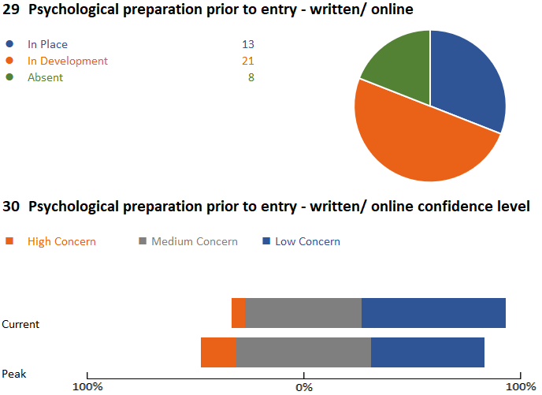
4. Psychological preparation for returning staff – written or online
31% of organisations in the south east have developed written materials to support the psychological preparation of returning staff (BBS scheme or similar) with 50% developing this offer. The 19% of organisations (8) who have not prepared this material pose a concern. 57% of organisations express medium or high concern regarding this during the peak period.

Slide 19
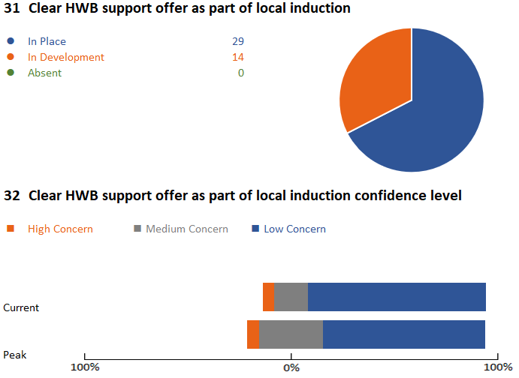
4. Clarity of HWB offer in induction process for returning staff (2)
67% of organisations in the south east have a clear HWB offer included in the induction process for returning staff with 33% developing this currently. 30% of organisations express medium or high concern regarding this during the peak period.

Slide 20
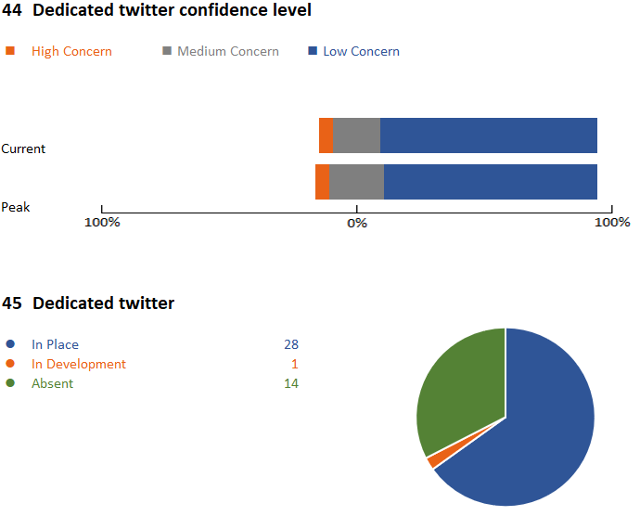
5. Communication of HWB offers
A significant majority of organisations in the south east (84%) express confidence (low concern) in communication of HWB offers locally through a dedicated intranet site and via other forms of social media. 65% of organisations have a dedicated twitter feed to promote HWB offers, with 23% of organisations expressing medium or high concern regarding this during the peak period.

Slide 21
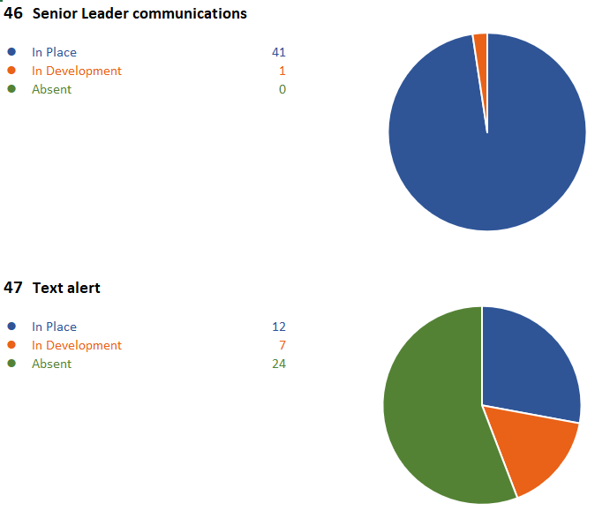
5. Communication of HWB offers (2)
Nearly all organisations in the south east have dedicated senior leader communications regarding COVID 19 and staff HWB. 44% of organisations are either using or developing text alerts to update staff regarding offers, however the other 56% aren’t planning to use or develop this, which could be due to the use of more immediate and less labour intense methods such as social media platforms.

Slide 22
16. Communication of HWB offers (3)
Other methods of communicating HWB offers
YouTube, video links
Prolific use of social media (Private FB, Whatsapp, Twitter)
Posters/flyers/leaflets being distributed to promote current offer and updates to offers
Using Glisser for all staff briefing by the Chief Exec, live streamed on internal and external website with real-time Q&A
MS Teams, Zoom, Skype
All user emails
Weekly Webinars
Daily staff bulletin
Exec virtual Q&A
Top tips for leaders weekly
Dedicated page on the staff zone
Internal virtual drop-ins
CEO vlog
Screensavers

Slide 23
Next steps
Once the regional and STP/ICS data has been shared, support can be given for the areas where medium / high concern has been highlighted at peak demand, or where there are gaps in the support being offered / provided, with the dedicated national teams working on categories of support to be able to target the support where it is needed the most.
We will need to find agile ways to capture the excellent local practice so that ideas can be shared and scaled across the region and wider where applicable
Further analysis needs to take place to explore the use of psychological interventions at the different phases of the COVID 19 crisis to ensure organisations are using clinical evidence to support the right intervention at the right time.
Continual liaison / relationships with experts in psychological and emotional provision to prepare interventions for the later (recovery) phase.

Slide 24
Contacts for your STP/ICS
Bucks, Oxon and Berkshire West: Alison.Jennings@leadershipacademy.nhs.uk
Frimley: Alison.Jennings@leadershipacademy.nhs.uk
Hampshire and the Isle of Wight: Jayne.Beresford@leadershipacademy.nhs.uk
Kent and Medway: Helen.Edmunds@leadershipacademy.nhs.uk
Surrey Heartlands: Helen.Edmunds@leadershipacademy.nhs.uk
Sussex and East Surrey: Kerry.Moody@leadershipacademy.nhs.uk

Slide 25
Thank you.

