Slide 1
HWB Stocktake Update Physical Health & Wellbeing South East Region 10 April 2020 Alison Jennings / Helen Edmunds

Slide 2
Summary
In response to COVID 19 we are working in close collaboration with organisations across the NHS to ensure appropriate health & wellbeing (HWB) support is in place and functioning effectively
To determine the current state of HWB provision we conducted a rapid COVID-19 Health & Wellbeing Stocktake from 4-8 April with NHS organisations primarily focusing on Trusts but with some responses from CCGs and others (County Council; Hospice)
To date 178 organisations have participated nationally, of which 41 of these have responded for the SE, in this Physical HWB stocktake and provided responses to four categories of support which have a series of questions designed to explore provision for staff in the following areas (some questions weren’t applicable to every organisation):
Transport
Accommodation
Food
Childcare
The stocktake will remain open and the regional HWB Lead will work with Trusts yet to respond.
The data will be further analysed by STP/ICS and will channel support to the areas of greatest need / where organisations have highlighted areas of ‘high concern’.

Slide 3
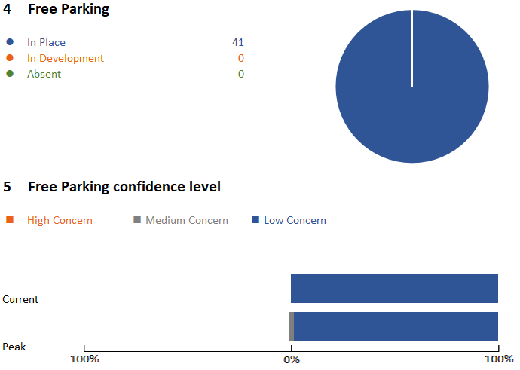
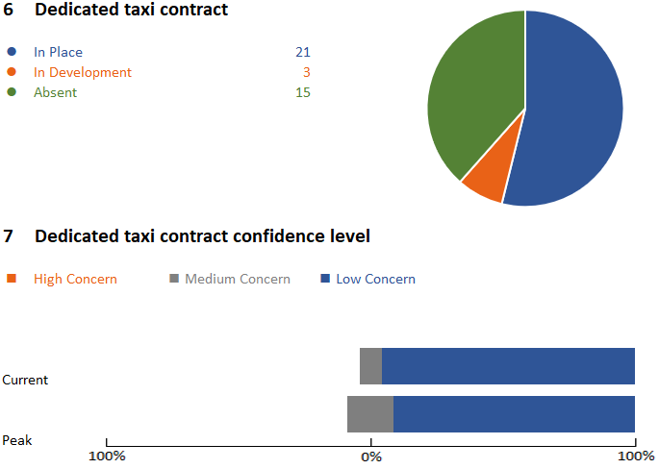
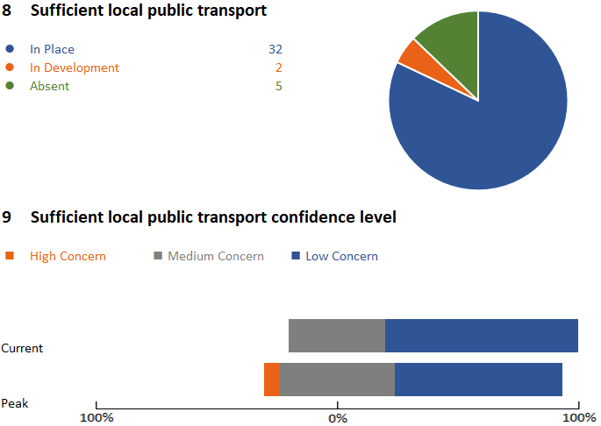
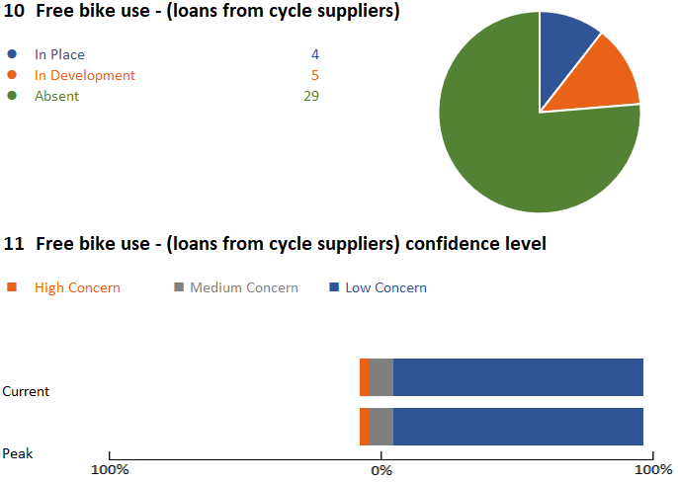
1. Transport
Transport to work appears to be of mainly low concern across all subcategory questions. Free parking, local public transport, dedicated taxi contracts for provider Trusts and clear local guidance on transport suggests that the majority of organisations have confidence staff have suitable travel to work currently and during any peak. There are 2 organisations who have a high concern relating to sufficient local public transport at peak demand, with one of these also reporting high concern at there being clear travel to work guidance in relation to CV19. There is 1 other Trust highlighting high concern in relation to free bike use at peak demand.

Slide 4
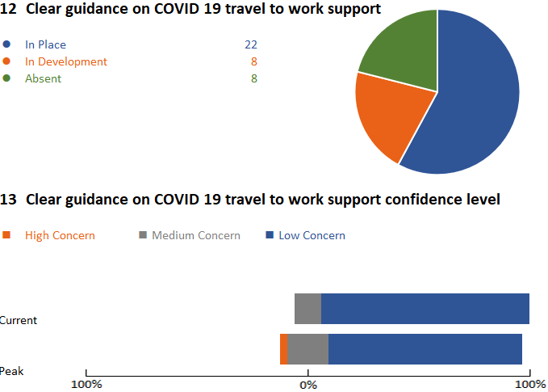
Transport (2)
Innovative ideas to share
Car rental companies offering free car use/ heavily subsidised
Local coach companies offering minibuses
Volunteer drivers offering transport to and from hotels / stations
Car companies loaning cars
Financial support for taxi’s being offered
Free Uber for NHS Staff via NHS Mail account
Staff with lease cars offered MOT advice
Transport page on Trust intranet
Request help/ support to deliver
Transport to rural sites
Reduced service on public transport – alternative options for unsocial hours / shift workers

Slide 5
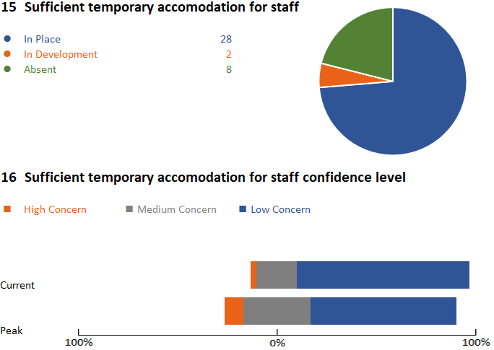
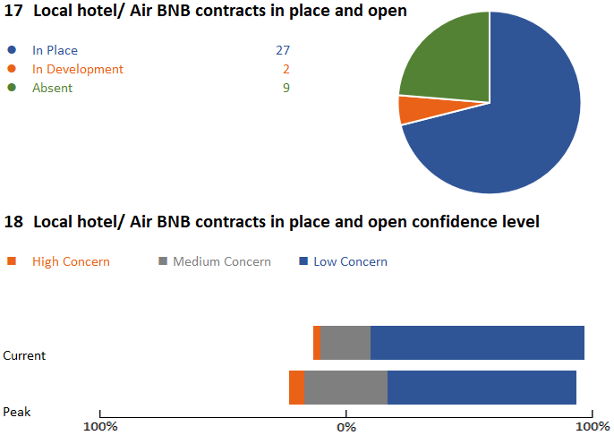
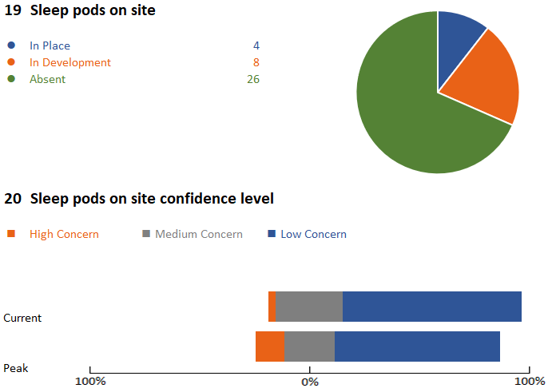
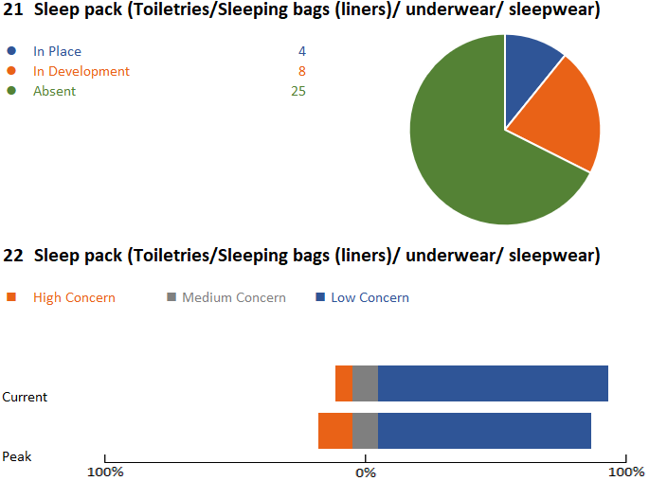
2. Accommodation
Accommodation seems to be of low concern for the majority of organisations. 69% of organisations (who answered these questions) have sufficient temporary accommodation in place, with 3 organisations highlighting this as a high concern in peak demand. The scaling of temporary accommodation guidance/ innovative ideas should meet any further demand. There is a wide use of national accommodation helpline and local hotels/ Air BNB. Only 12% of organisations in the SE are using sleep pods, with a further 19% having this in development and 4 organisations highlighting this as a high concern in peak demand.

Slide 6
2.Accommodation(2)
Innovative ideas to share
Temporary ‘Olympic style villages’ with support services, buses and pop up supermarkets
Innovative pop up ‘village’ using converted shipping containers
Sleep packs of toiletries/ underwear
Use of local university accommodation and amenities
Hampers provided in accommodation including toiletries
Sleeping bags provided that are NHS branded
Using vacated medical students accommodation as temporary rest rooms during / between shifts
Request help/ support to deliver
Use of Butlins/ Centre Parcs – holiday villages that are closed and could be used – could this be nationally agreed?
Advice and support on accessing/ sourcing sleep pods
Working with local universities on vacant student accommodation

Slide 7
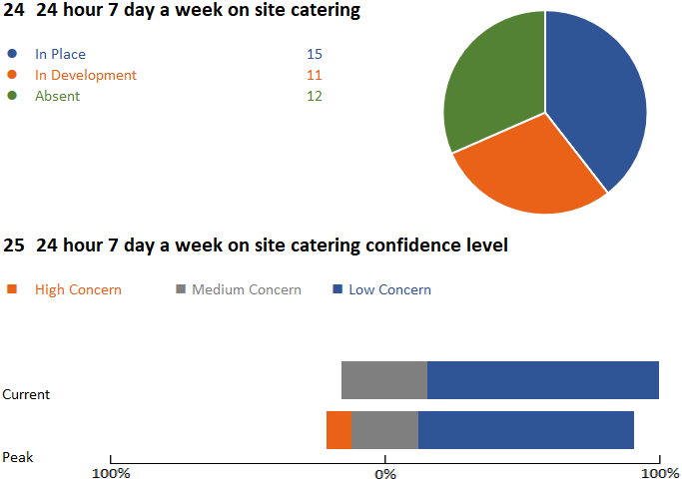
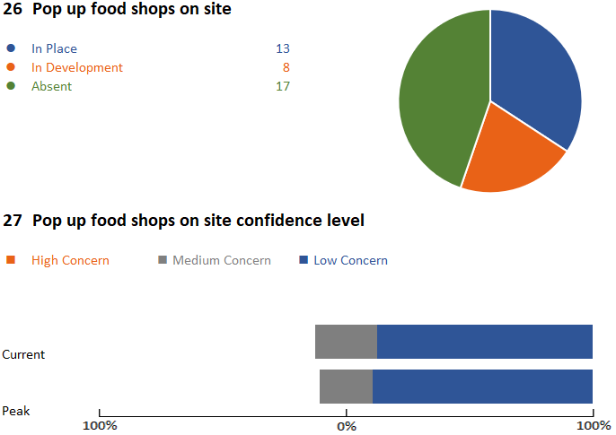
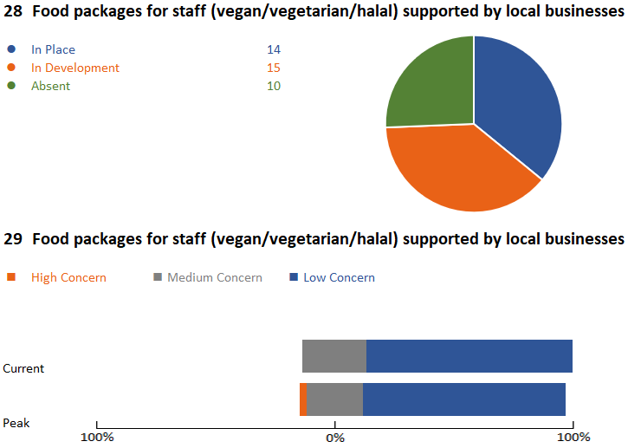
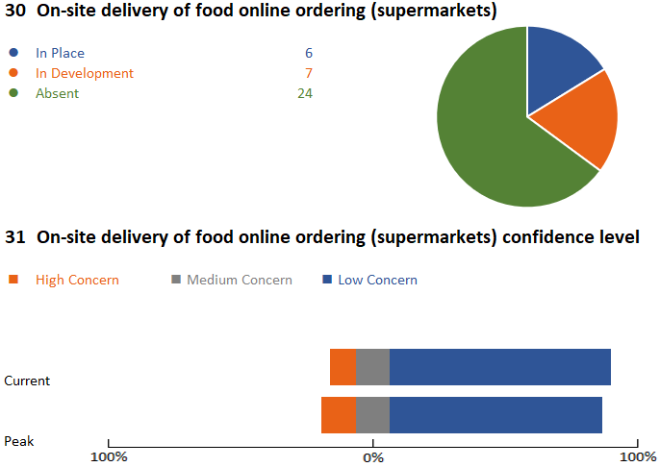
3. Food
Provision of food is less comprehensive and is also varied in delivery. Again, we need to note that some respondents are either CCGs/ Community and/ or Mental Health Trusts who may not have the same need to provide accessible food as Acute Trusts. Most organisations are confident (have low concern) in the provision of food for staff currently and during the peak. However the free text responses show a significant variation in the level of food provision and funding to support this – some offer fully funded meals and others a subsidy, voucher or no subsidy at all. A clear guide on what ‘good’ looks like would be useful to encourage some organisations to step up and do the right thing.
.

Slide 8
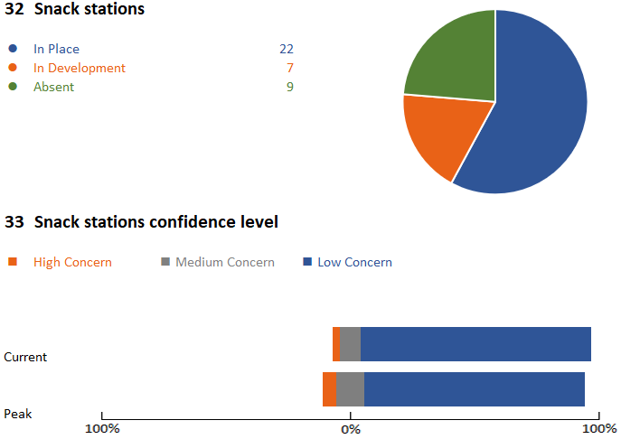
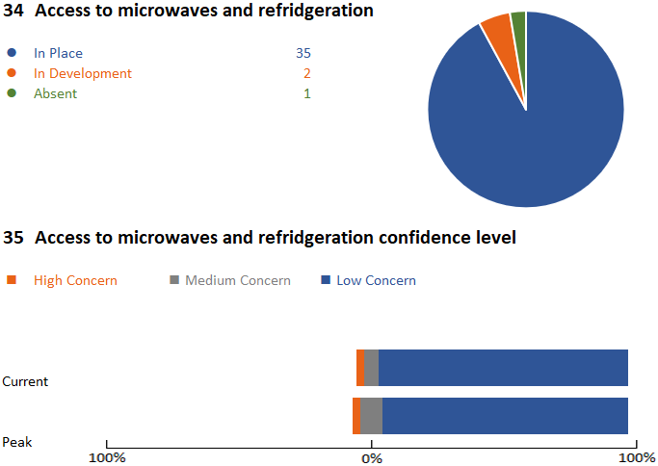
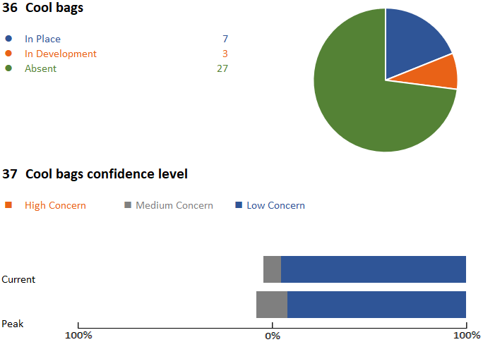
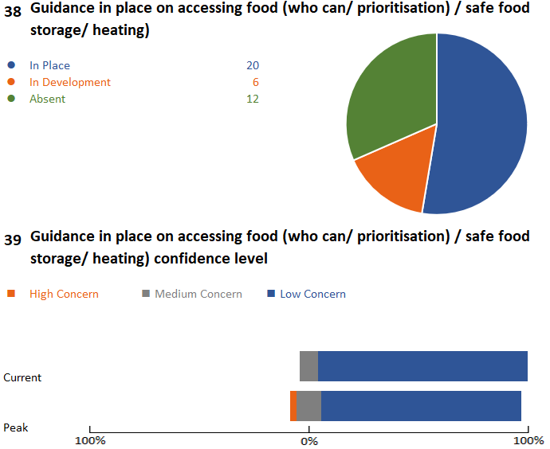
3. Food (2)
Ambulance services and other multi-site organisations tend to be the organisations using cool bags or packed lunch provision. 3 organisations highlighted high concerns at peak demand for providing 24/7 on site catering, whereby alternative provision would become more important. 4 other organisations highlighted high concern with on-site delivery of food online shopping in peak demand, which would raise the importance of other provisions for staff such as access to pop up shops for essential food items.

Slide 9
3. Food (3)
Innovative ideas to share
Food and treat boxes in rest rooms/ wobble rooms
Treat box deliveries to wards twice weekly from charitable funds
Pick me up packs sent to wards
Food bank provisions stock piled with essential items for staff
Concierge service set up for staff
Free pizza vouchers given to staff
Easter egg donations given to organisations for staff
Ambulance CFRs (1 vehicle per operating unit) providing food deliveries to staff at hospital handovers
Fully funded hot meal each day for all COVID 19 or inpatient staff
Grab and go bags available at hospital restaurants
Meal vouchers being provided from charitable funds
Free packed lunches to all COVID 19 staff
Fine dining meals offered at cost price
Numerous pop-up shops

Slide 10
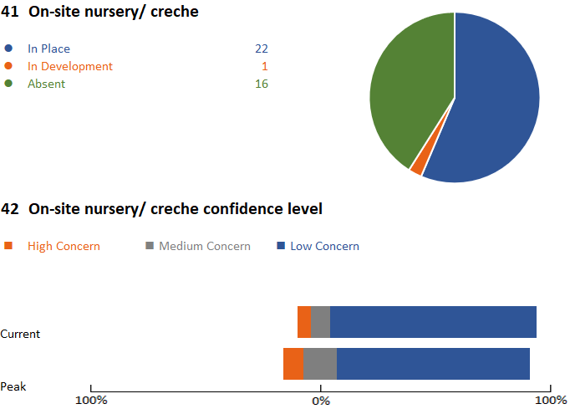
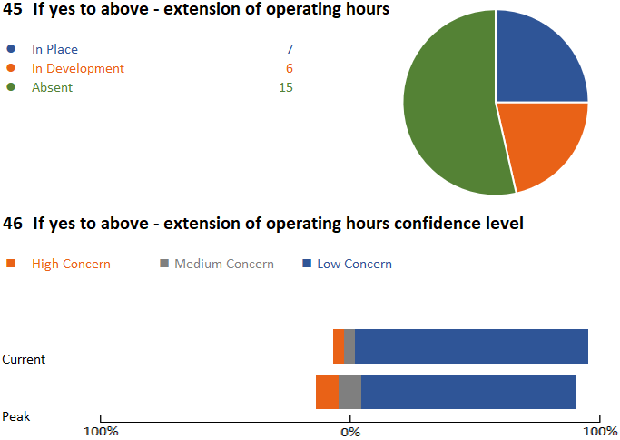
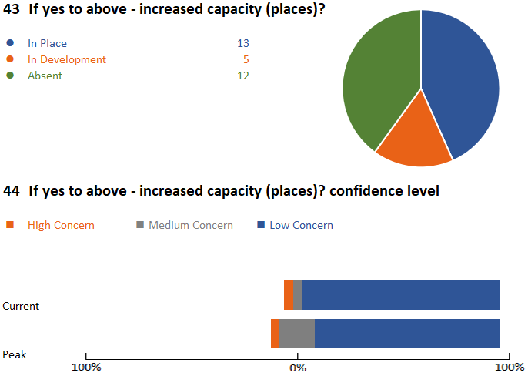
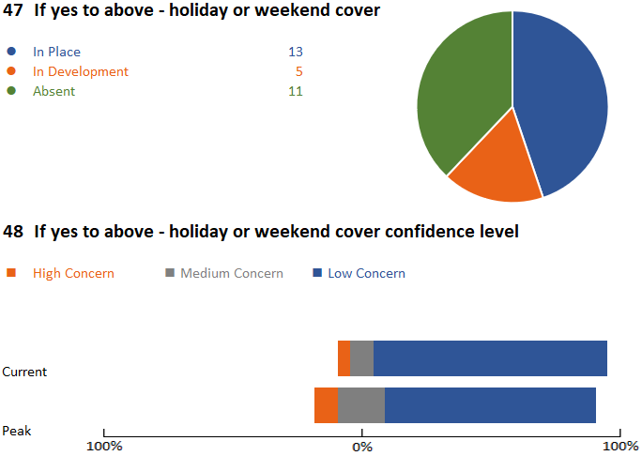
4. Childcare
This section of the questionnaire will show variation in response as just over half (53%) of organisations responding in the SE have on-site nursery / creche facilities. Organisations are working closely with their Local Authorities and if they have on-site facilities, a large proportion have extended their capacity and hours and 57% are now offering weekend / holiday cover and a further 22% are developing this. Some organisations acknowledge that staff are not taking up the opportunity for more childcare due to cost or other reasons which may contribute to workforce pressure during the peak. Funding to support additional costs would be welcomed.

Slide 11
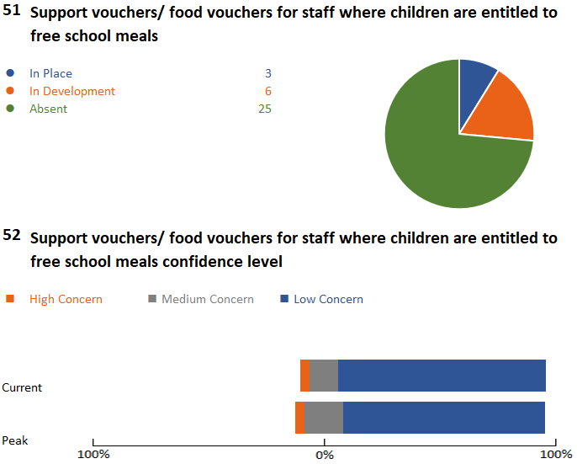
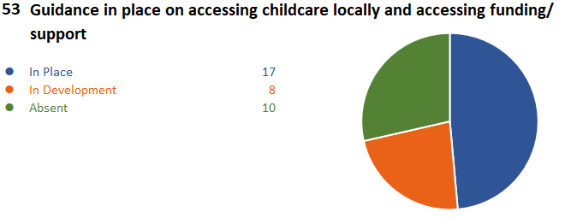
4. Childcare (2)
4 organisations in the SE have highlighted high concern at peak demand in their provision of on-site childcare, with 2 of these organisations also expressing high concern at their ability to extend provision. This could add to the staffing pressure should this provision be unavailable to frontline staff. 60% of organisations completing the stocktake have guidance in place or are developing guidance on accessing childcare / funding suport locally, sharing these across the region could support others to provide guidance.
Innovative ideas to share
Use play therapy staff to increase provision
Liaising with local children's’ holiday club provider to extend their services
Offer of reduced rates / spreading payment for childcare
Use of a local nursery to extend capacity covering 7 days a week
Request help/ support to deliver
Concern on low levels of uptake of extended hours – what messages do we need to share with staff to encourage uptake
Reduced childcare opening hours due to illness or self-isolating
Creation of a hardship or welfare fund for staff in financial difficulty
How to support families who access free school meals

Slide 12
Next steps
Once the regional and STP/ICS data has been shared, support can be given for the areas where high concern has been highlighted at peak demand, or where there are gaps in the support being offered / provided
We will need to find agile ways to capture the innovative practice so that ideas can be shared across the region and wider where applicable
Ongoing work / liaison with the national HWB team to promote national contracts to support staff

Slide 13
Contacts for your STP/ICS
Bucks, Oxon and Berkshire West: Alison.Jennings@leadershipacademy.nhs.uk
Frimley: Alison.Jennings@leadershipacademy.nhs.uk
Hampshire and the Isle of Wight: Jayne.Beresford@leadershipacademy.nhs.uk
Kent and Medway: Helen.Edmunds@leadershipacademy.nhs.uk
Surrey Heartlands: Helen.Edmunds@leadershipacademy.nhs.uk
Sussex and East Surrey: Kerry.Moody@leadershipacademy.nhs.uk

Slide 14
Thank you.

