Slide 1
HWB Stocktake Update Occupational Health Service Provision South East Region 15 April 2020 Alison Jennings / Helen Edmunds

Slide 2
Summary
In response to COVID 19 we are working in close collaboration with organisations across the NHS to ensure appropriate health & wellbeing (HWB) support is in place and functioning effectively
To determine the current state of HWB provision we conducted a rapid COVID-19 Health & Wellbeing Stocktake from 4-8 April with NHS organisations primarily focusing on Trusts but with some responses from CCGs and others (County Council; Hospice)
To date, the organisations who have participated in this Occupational Health (OH) services stocktake across the south east (37) have provided responses which look at:
How is the service provided – internally or externally?
Existing local enhancement of occupational health services
Capacity and concerns in coping with peak/ surge
Additional support from the centre or regionally – what is the ask?
The stocktake will remain open and Regional HWB Lead will work with Trusts yet to respond.
The data will be further analysed by STP/ICS and will channel national and regional support to the areas of greatest need

Slide 3
1. How is the service provided?
There is an even split across the responding organisations regarding internal provision of occupational health services or outsourcing to an external provider. However, we know that larger organisations have more ability to bring this service in-house. The stocktake data will allow us to triangulate organisation size through to how services are provided (internal/ external).
Question 4 - For those organisations who have outsourced provision, we have a list of their service provider.

Slide 4
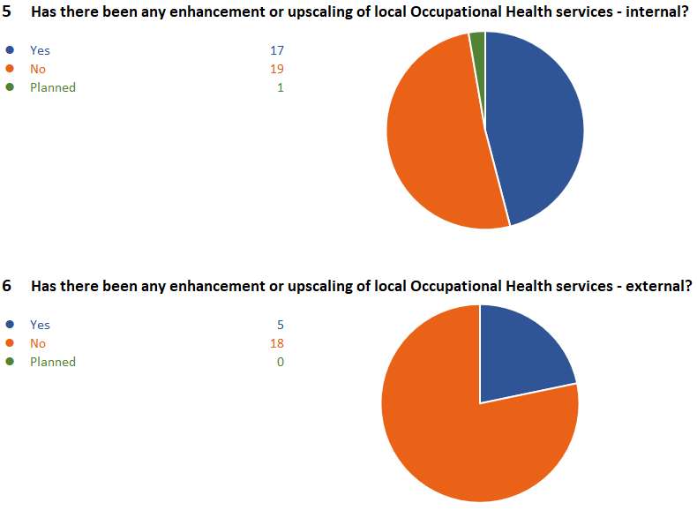
2. Existing local enhancement of occupational health services
There is a significant difference between the upscaling of internal OH services versus those provided externally (46% versus 14%). The stocktake did not interrogate the decision to enhance or upscale service provision but concerns on costs for external providers was mentioned in a later question and could offer a possible explanation for this difference.

Slide 5
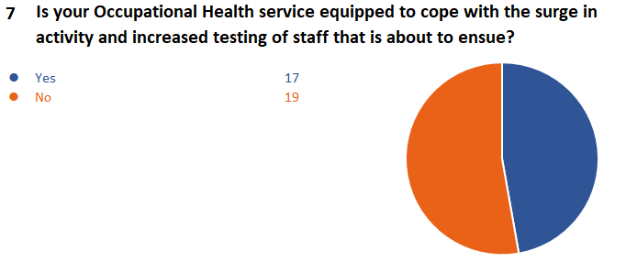
3. Capacity and concerns in coping with peak/ surge
Almost half (46%) of organisations report that they are equipped to cope with the surge in activity and increased testing of staff. However, it should be noted that the free text questions identify that there are different models in place with many OH teams not providing testing as another dedicated team has been tasked with this work. Different concerns exist for those providing testing and those who are not. For those providing testing it is capacity and the de-prioritisation of BAU OH work that is the main concern (slide 6). For those who are not providing testing, resources and capacity to meet demand such as mental health issues and pre-employment checks are the key concerns (below).
Most common concerns – general OH provision
Most significant concerns are lack of capacity of OH staff/ facilitates/ equipment/ IT – resources to either meet increased demand for BAU OH activities which have increased such as pre-employment checks for BBS or for testing (if the OH team is being tasked with this work – see next slide)
OH teams already depleted due to vacancies or sickness are struggling
OH teams tasked with testing are struggling to provide BAU services which will have a knock-on effect on available workforce
Burn out/ resilience issue of OH teams due to increased demand
The ability to support COVID 19 mental health issues is compromised due to demands such a pre-employment checks for BBS
External provider will not increase their provision
Demand during the surge or peak is unknown nor is its duration
Support for fast track employment clearance

Slide 6
3. Capacity/ concerns in coping with peak/ surge (2)
Concerns – OH teams providing testing
Most significant concerns are lack of capacity of OH staff/ facilities/ equipment/ consumables / IT/ space to manage testing
Capacity to process results
Trained OH staff to provide results and manage concerns/advise staff on their results
New OH provider in place – their ability to meet demand and manage testing is an unknown
Concerns that private OH provider will not have the ability to meet capacity demands
OH provider not undertaking staff testing

Slide 7
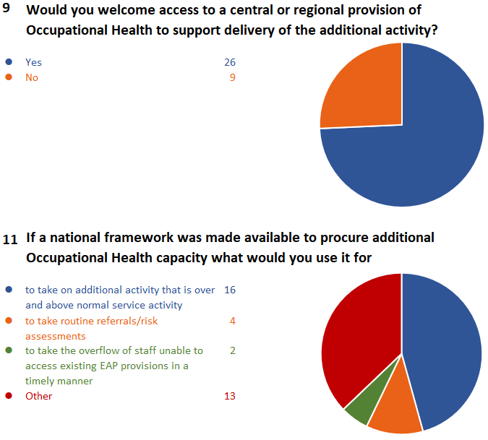
4. Additional support from the centre or regionally
A significant majority of organisations would welcome additional support from the centre or regionally (74%). A breakdown of what additional support they would utilise is outlined in Q.11. Slide 8 (overleaf) outlines specific requests for support or ideas for what centralised or regional support would add most value.

Slide 8
4. Additional support from the centre or regionally (2)
Examples of requests for additional support
A central advice line for staff who are self-isolating due to PHE guidance on high risk groups
Sourcing specialist OH staff to meet capacity demand
Increased capacity to support testing
Increased capacity for BAU referrals
Case management and importing of testing results
Central hub for lab testing
Resource for co-ordination of testing
Phone enquiry line for OH
Provision of expert testing advice – a centralised helpline to support staff in receiving results and managing any impacts
Specific OH guidelines for redeploying employees who are classified as 'At Risk' but not in the vulnerable category.
Funding for occupational health practitioners and consultants
Support with swab results service/ outsourcing of swabbing
Working from home or other risk assessment reports – could this be managed regionally or centrally through a call centre?
Additional support for pre-commencement health clearance / fast track employment clearance
Additional resource for management of sickness referrals
Clearer national guidance aimed specifically at OH services
Additional psychological support for trauma

Slide 9
Next steps
Once the regional and STP/ICS data has been shared, support can be given for where there are gaps in the support being offered / provided, with the dedicated national teams working on categories of support to be able to target the support where it is needed the most.
A database needs to be developed regarding the OH provision in Trusts – whether internal or external (and if so which provider) which will make targeting support and communications far more effective.
We will need to find agile ways to capture the excellent local practice so that ideas can be shared and scaled across the region and wider where applicable
How do we address the asks for central/ regional support?

Slide 10
Contacts for your STP/ICS
Bucks, Oxon and Berkshire West: Alison.Jennings@leadershipacademy.nhs.uk
Frimley: Alison.Jennings@leadershipacademy.nhs.uk
Hampshire and the Isle of Wight: Jayne.Beresford@leadershipacademy.nhs.uk
Kent and Medway: Helen.Edmunds@leadershipacademy.nhs.uk
Surrey Heartlands: Helen.Edmunds@leadershipacademy.nhs.uk
Sussex and East Surrey: Kerry.Moody@leadershipacademy.nhs.uk

Slide 11
Thank you.

